Slide 1
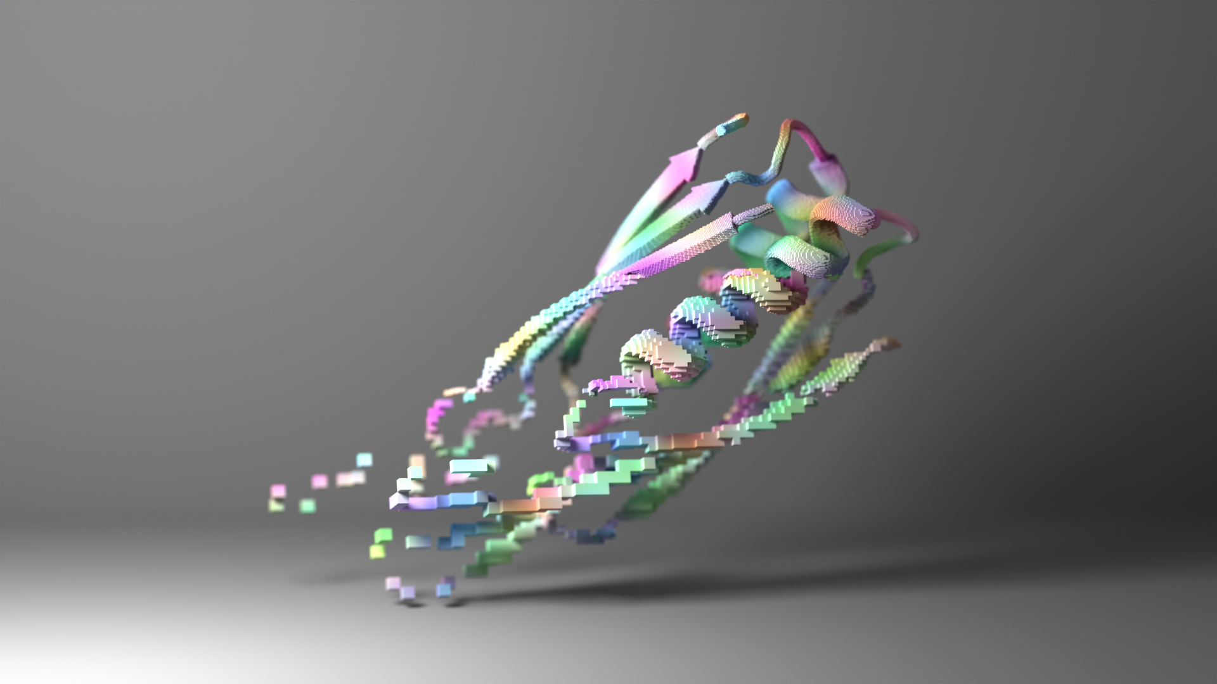
Protein Language Models and Protein Design
BIOINF 595 3/25
Matthew O’Meara
Notes:
http://bakerlab.org/2022/09/16/proteinmpnn-excels-at-creating-new-proteins/
artwork

Slide 2
Central Dogma
protein sequences
protein structures
protein functions
P(Sequence)
P(Structure)
P(Function)
P(Sequence, Structure, Function)

Slide 3
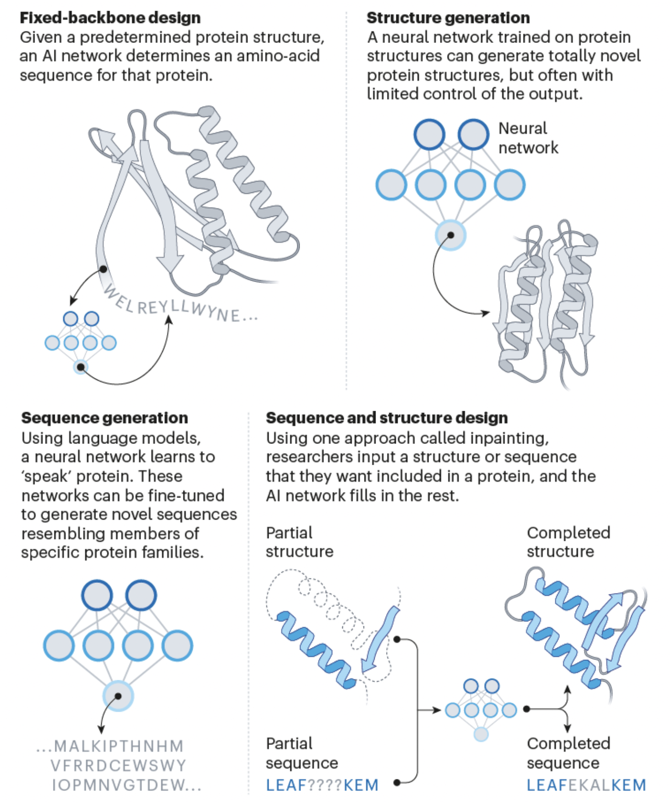
Tasks for protein design
P(Structure)
P(Sequence)
P(Structure | Sequence)
P(Structure, Sequence)
Notes:
bakerlab.org/2022/09/16/proteinmpnn-excels-at-creating-new-proteins/

Slide 4
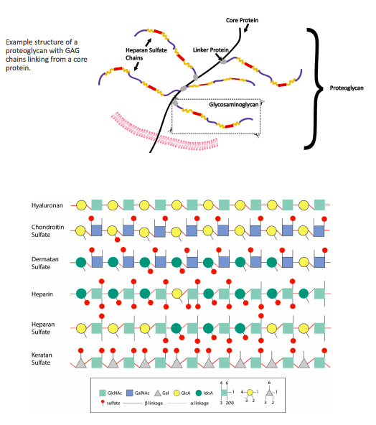
ChABC protein as a potential therapy

Slide 5
ChABC protein as a potential therapy

Slide 6
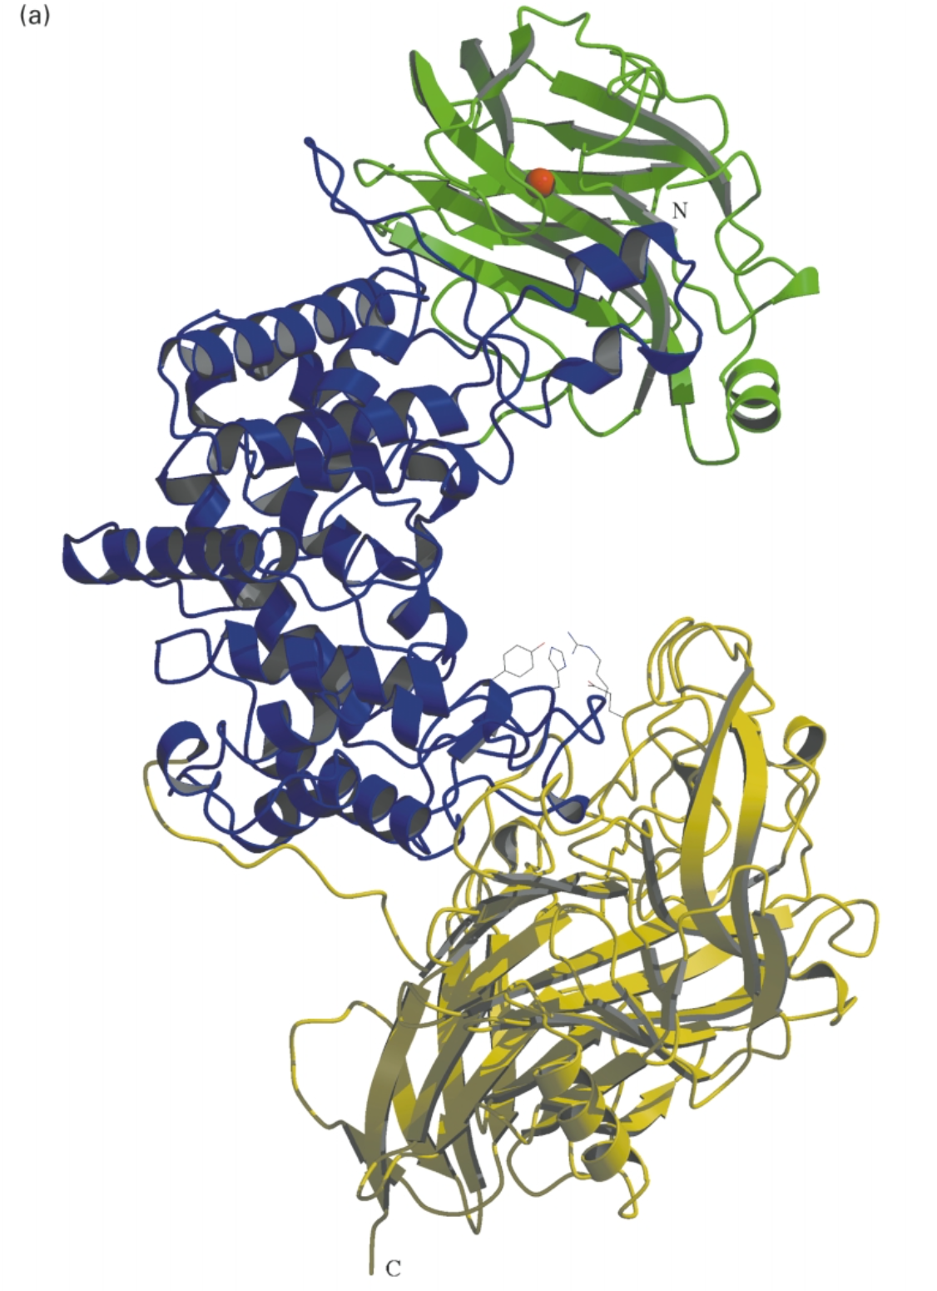
ChABC protein as a potential therapy
ChABC
Fibrous scar
P. Vulgaris
Found in gut microbiome
(Yamagata, 1968): Cloned ChABC
(Huang, 2003): X-ray crystal structure 1.9 A
(Barritt, et al., PNAS 2006)
ChABC promotes nerve regeneration in animals
UNSTABLE!! → 15 studies to stabilize marginal success
http://www.amsbio.com/brochures/proteoglycans-GAGs.pdf

Slide 7
Bacterial Chondroitinase ABC is the trypsin of glycomics
(Nilsson, JACMS, 2016)

Slide 8
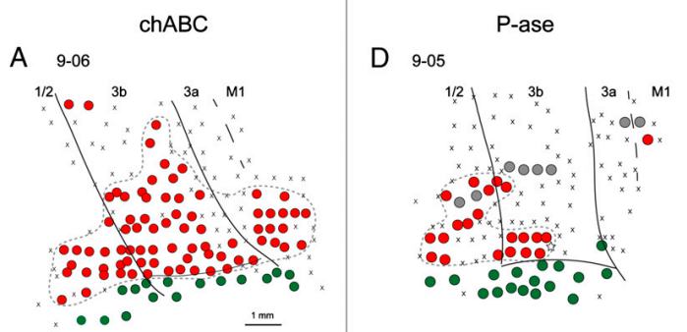
In Monkeys, ChABC reactivates nervous response
In a mouse model of stroke,
ChABC reduces lesion volume
(Bowes, PNAS, 2012)
(Hetteriatchi, O’Meara, et al., 2019)

Slide 9
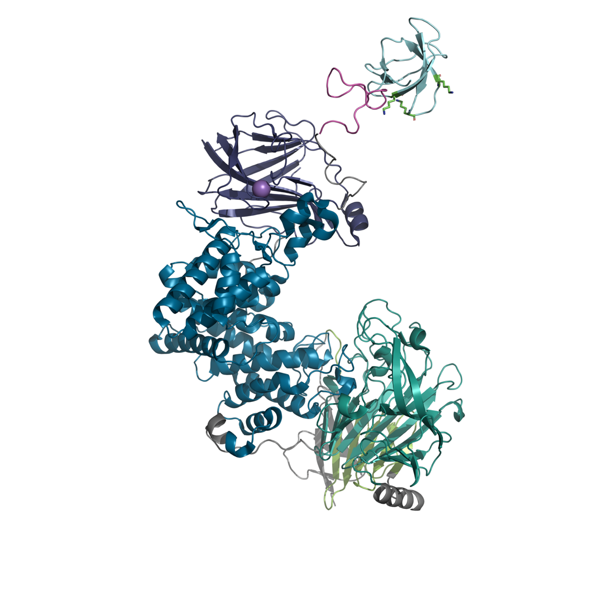
Controlled release with SH3 + hydrogel
SH3 domain
ChABC

Slide 10
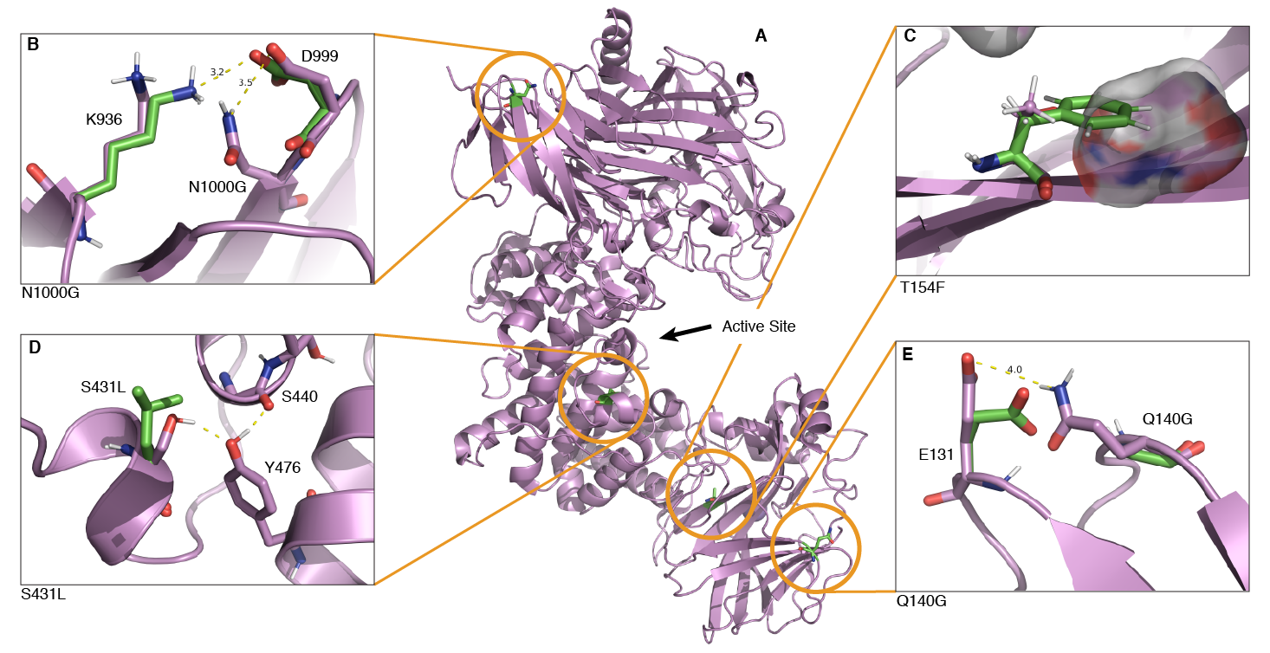
Rosetta PMutScan ddG:
(Hettiaratchi, O’Meara, et al., 2019)

Slide 11
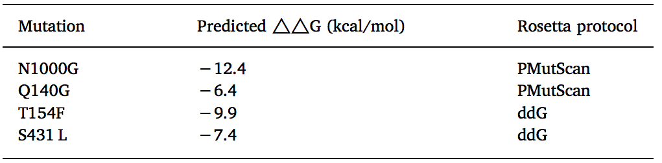
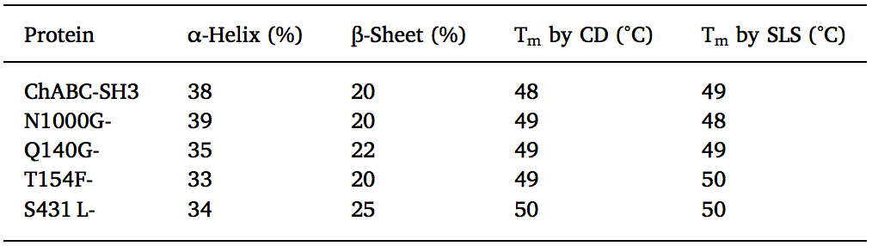
Predictions → Results

Slide 12
How to make ChABC useful?
Cloned from P. Vulgaris
(Yamagata, 1968)
1.3 A X-tal (Huang, 2003)
Half-life of ~hours
-> continuous diffusion ☹
12 Prior work to stabilize ChABC
-> 56 different mutants

Slide 13
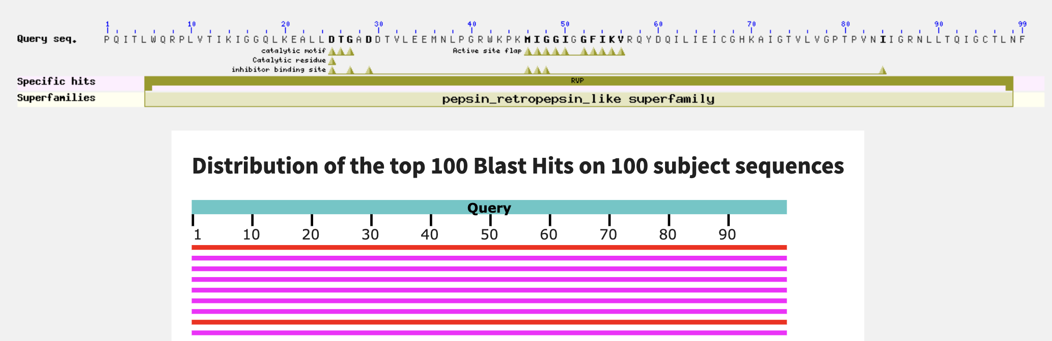
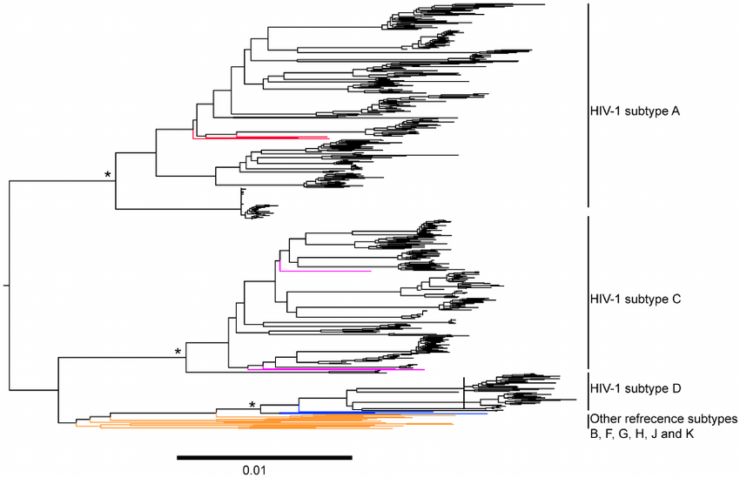
Sequence similarity => phylogeny
BlastP
https://blast.ncbi.nlm.nih.gov/Blast.cgi
>1HXW_1|Chains A, B|HIV-1 PROTEASEPQITLWQRPLVTIKIGGQLKEALLDTGADDTVLEEMNLPGRWKPKMIGGIGGFIKVRQYDQILIEICGHKAIGTVLVGPTPVNIIGRNLLTQIGCTLNF
Database of sequences
Phylogeny

Slide 14
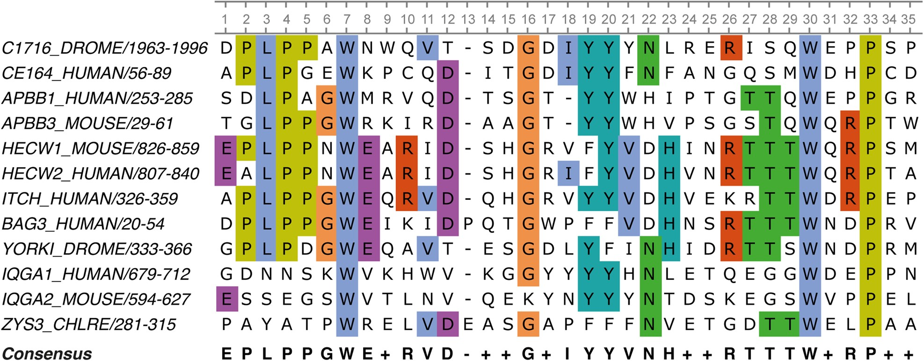
Consensus Design => mutate to most common residue
(Porebski, et al., 2016)

Slide 15
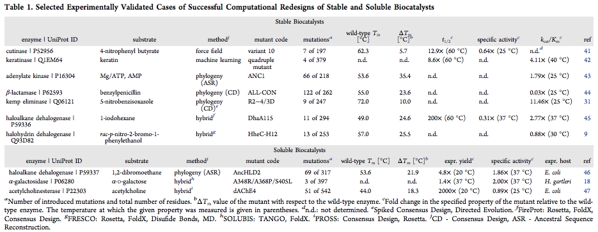
State of the art on stabilizing biocatalysts (~2018)
Musil et al. 2018)

Slide 16
PROSS Method
Constrained relax native structure into Rosetta Forcefield
Evaluate all point mutants with PSSM sequence restraint
Combine all independently stabilizing mutations in global sequence/structure design
https://pross.weizmann.ac.il
Adi Goldenzweig & Sarel Fleishman

Slide 17
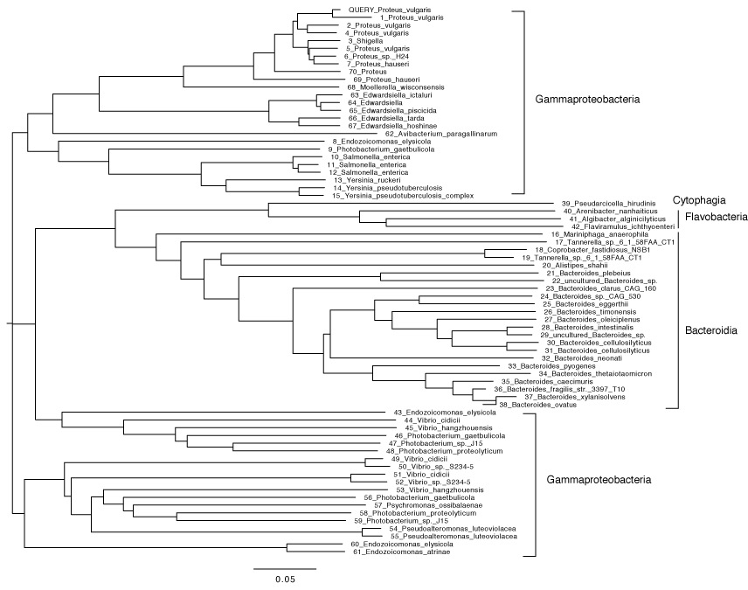
ChABC Evolution MSA

Slide 18
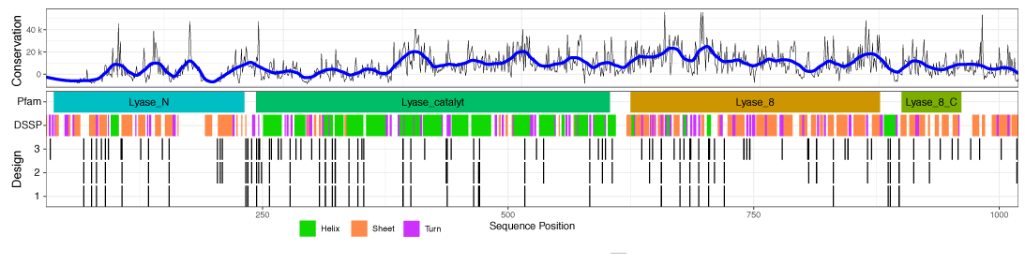
37 mutations
55 mutations
92 mutations

Slide 19
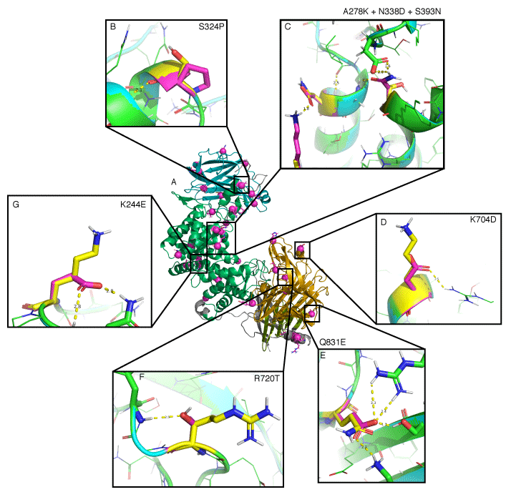
Example PROSS Mutations

Slide 21
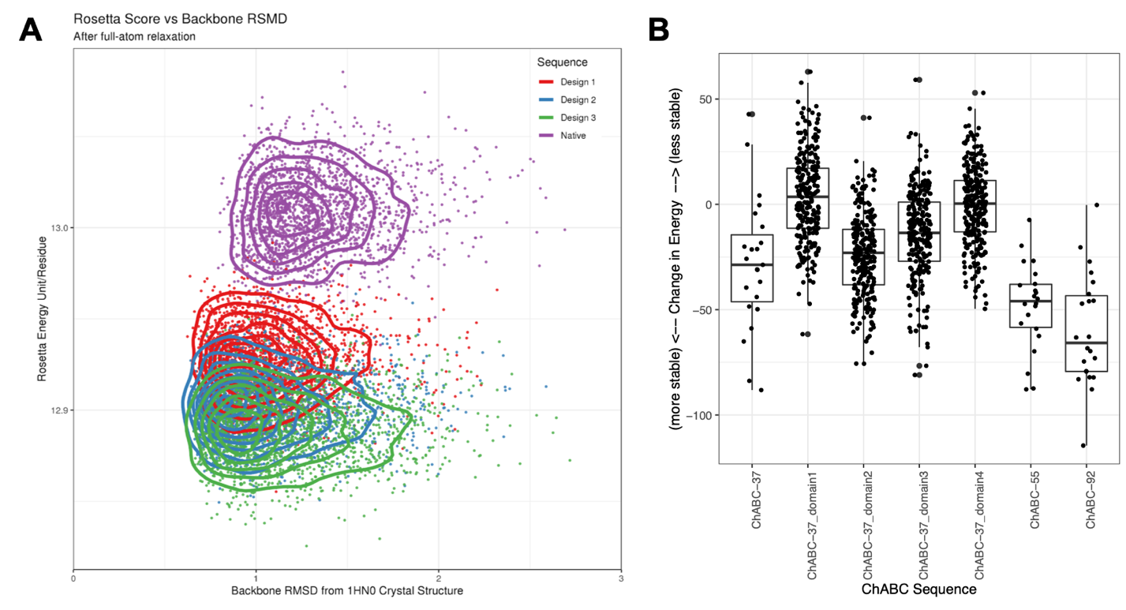

Slide 22
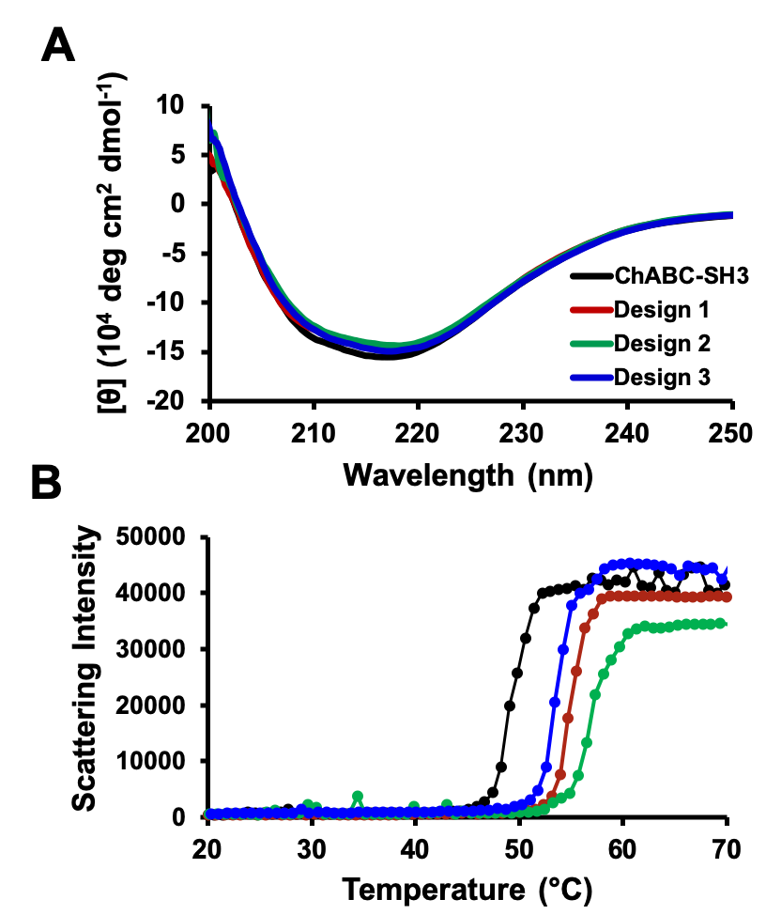
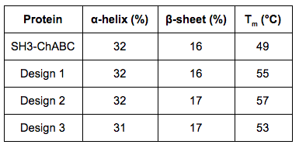
Thermo stabilized

Slide 23
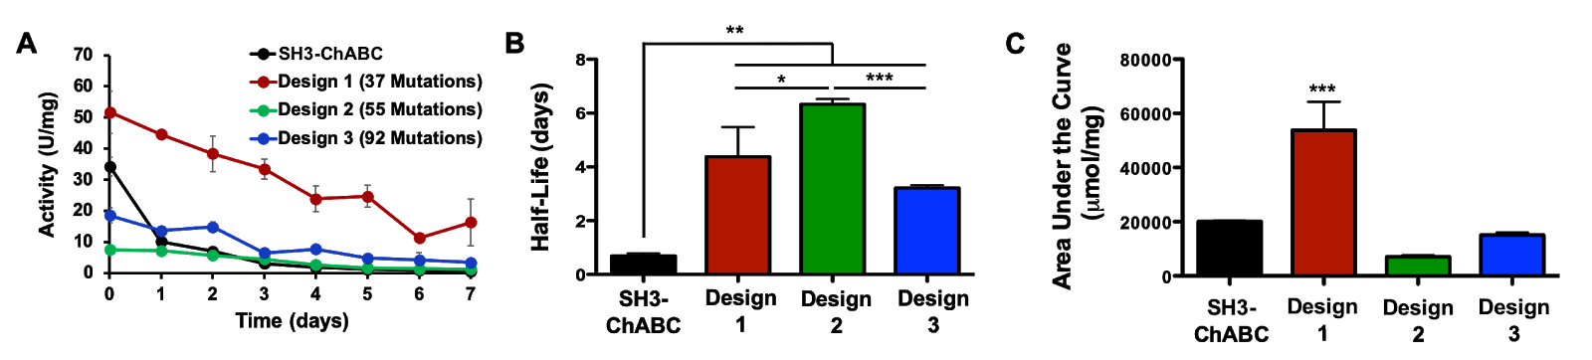
Longer half life

Slide 24
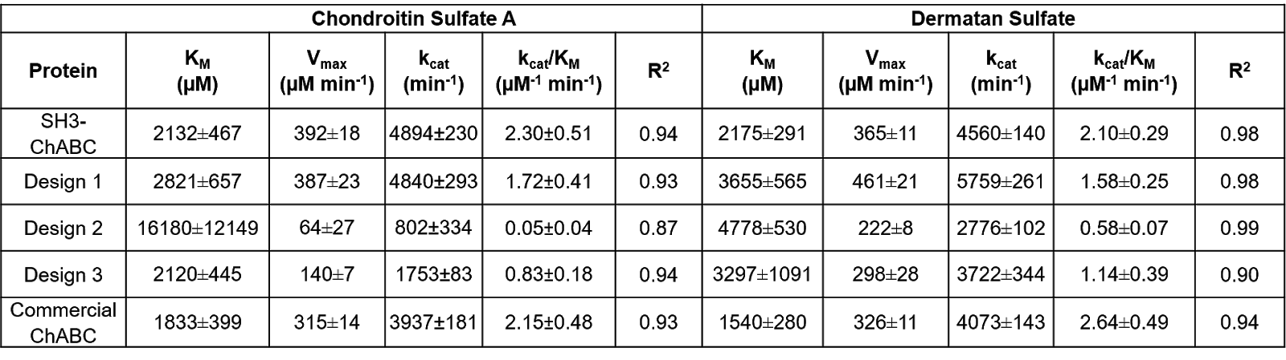
No Loss of enzymatic activity

Slide 25
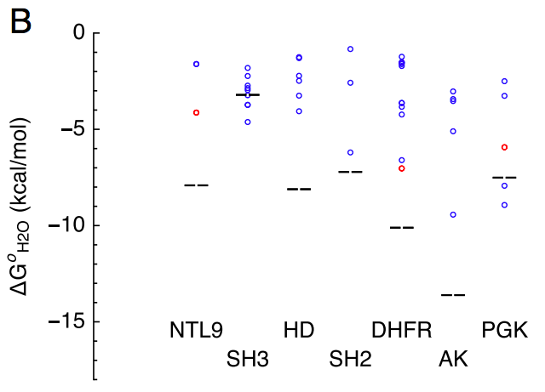
Consensus design is useful for stabilizing proteins…
Extant species
Consensus design
(Sternke, PNAS, 2019)

Slide 26
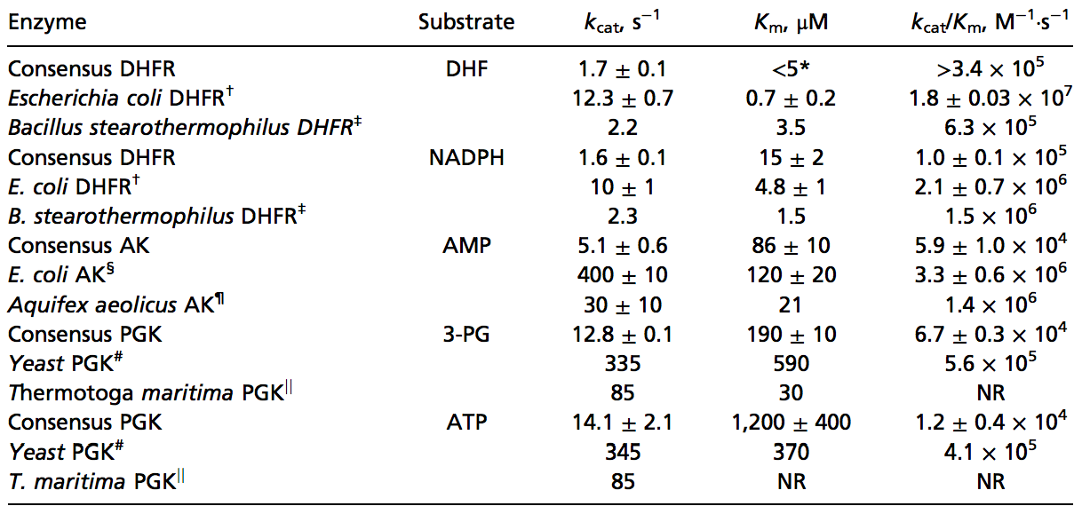
… but often wrecks function
(Sternke, PNAS, 2019)

Slide 27
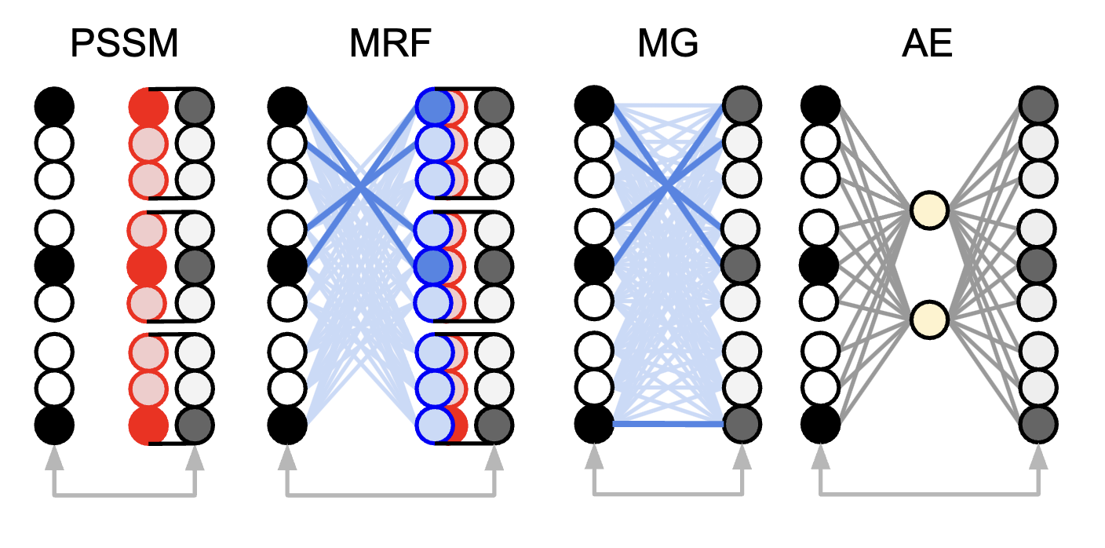
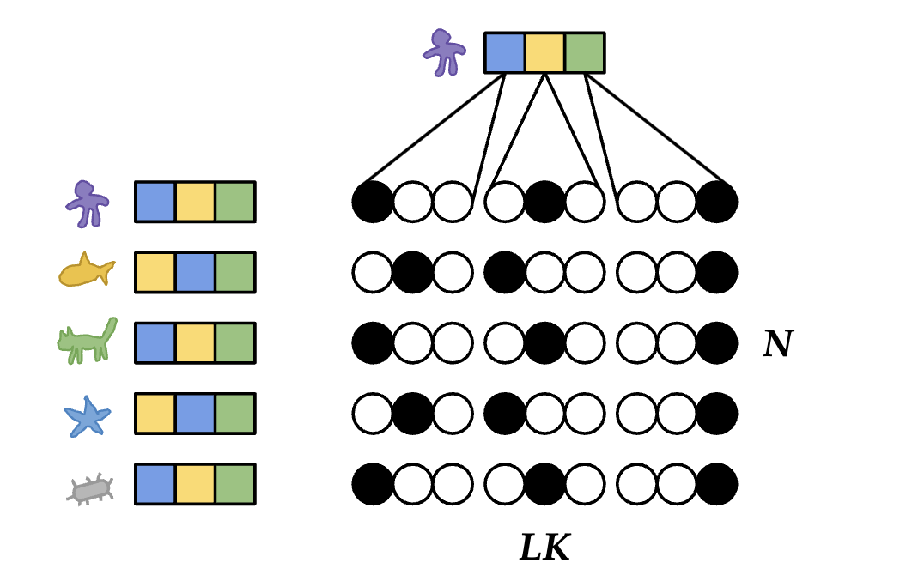
Single -> pairwise -> transformers
Position Specific Scoring Matrix
Markov Random Field
Multivariate
Gaussian
Autoencoder

Slide 28
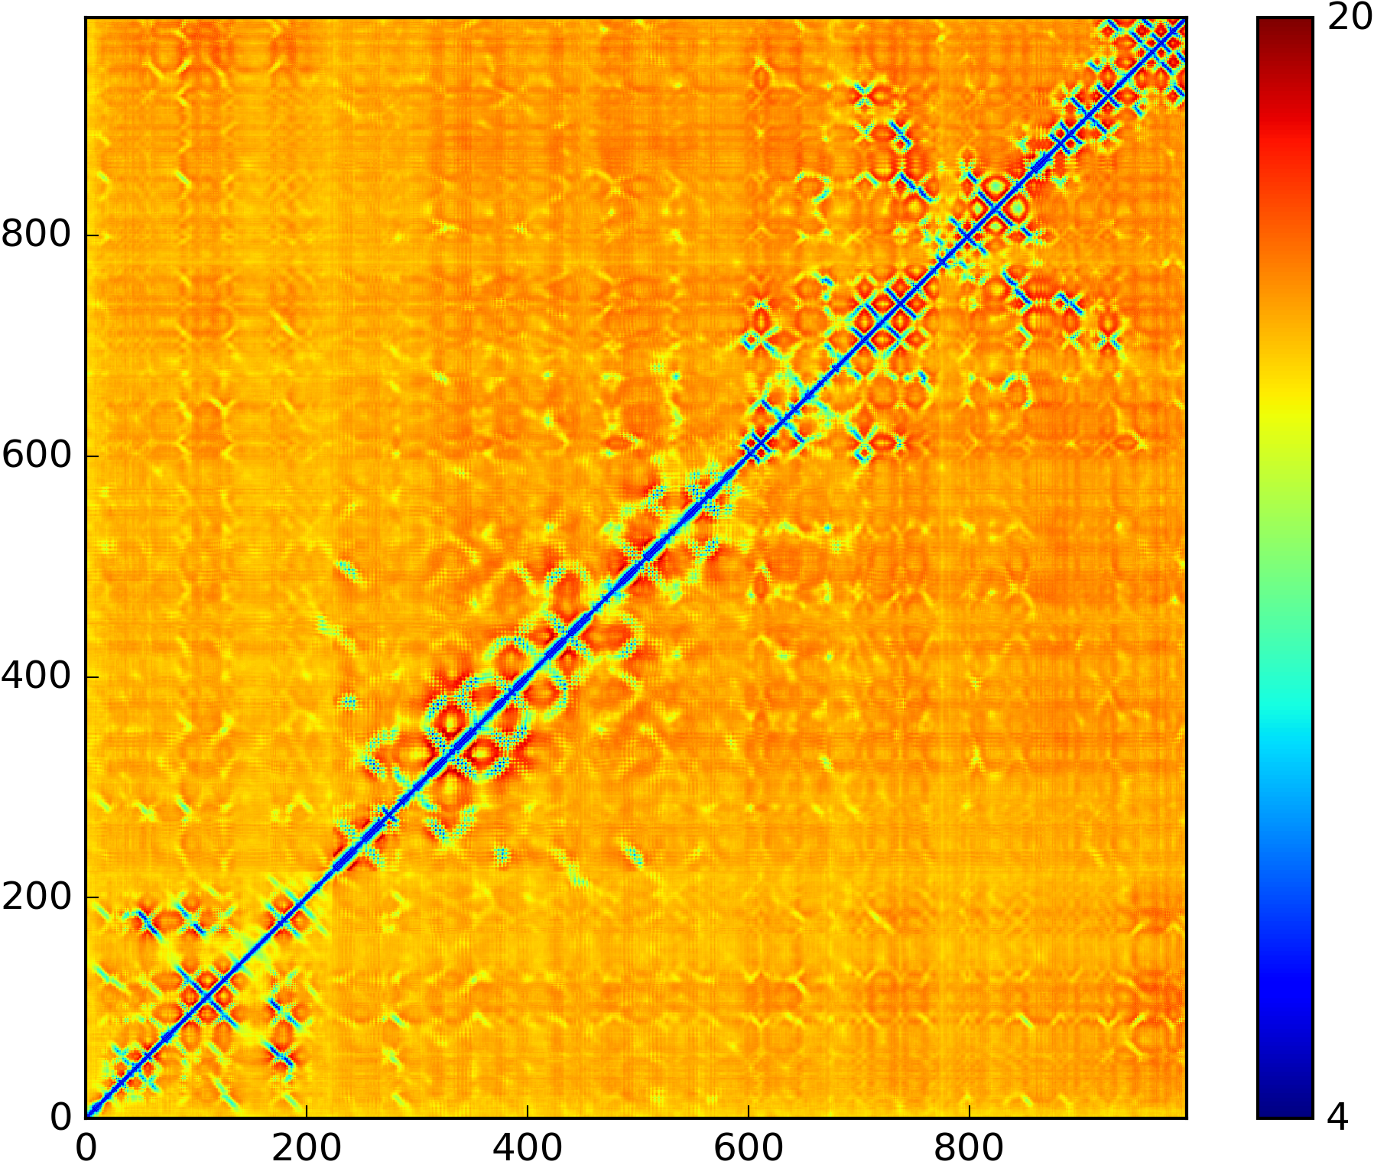
Co-variation?
ChABC Sequence (1021 residues)
DeepMeta (TrRosetta)
1851 sequences
GREMLIN MRF
Log probability of designs relative to wild type under GREMLIN MRF model (larger is better)
 | Total | 1-Body | 2-Body
ChABC-SH3-37 | -22.2 | 9.47 | -31.7
ChABC-SH3-55 | -27.0 | 15.2 | -42.2
ChABC-SH3-92 | -33.3 | 24.6 | -58.0
(Wu, Bioinf., 2020)
(Kamisetty, PNAS, 2013)

Slide 29
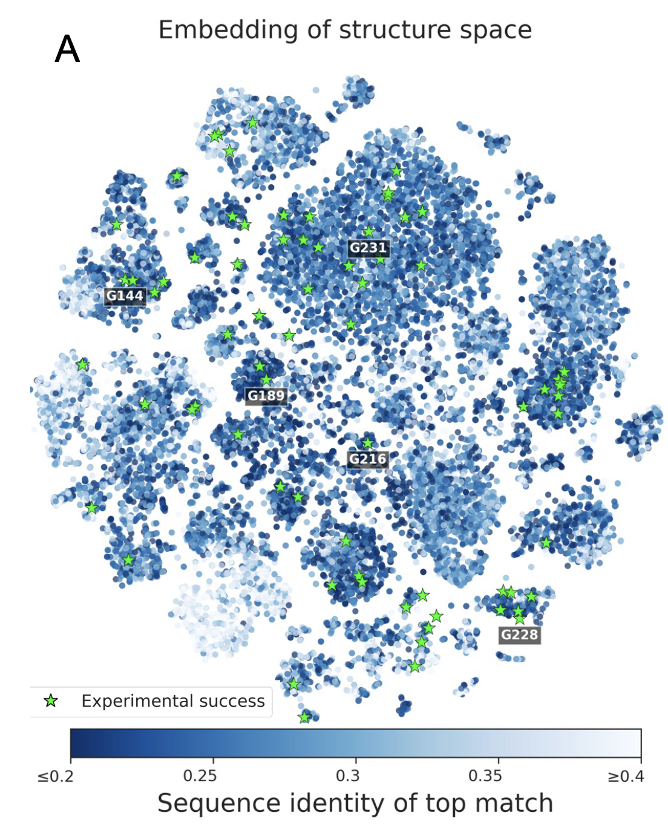
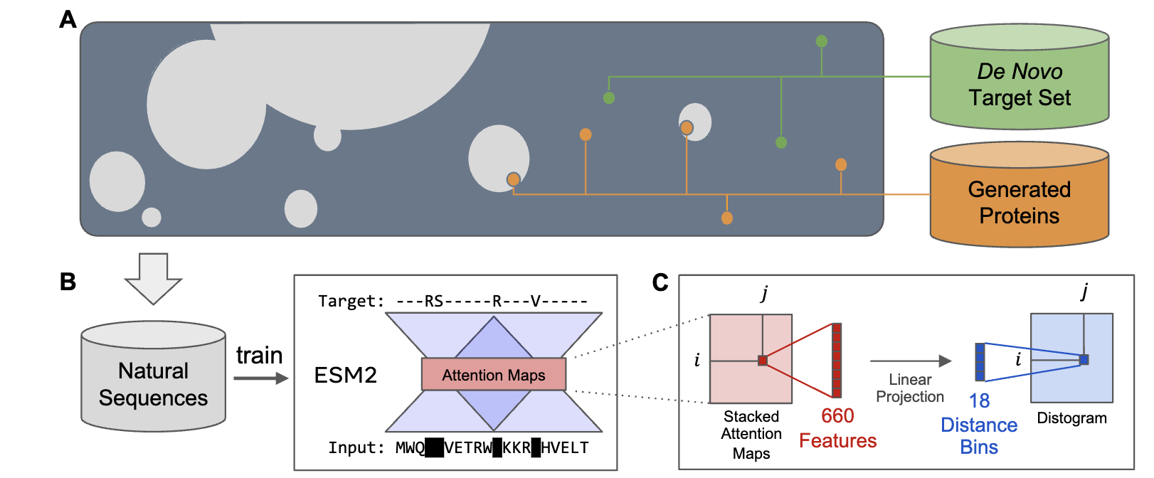
ESM-2 Embedding
(Rives, 2020)
(Verkuil, 2022)

Slide 30
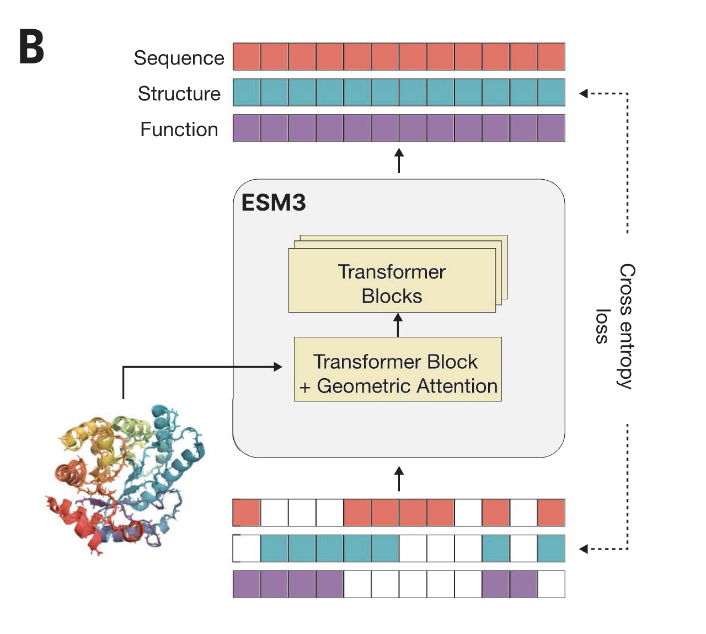
ESM3
Notes:
Simulating 500 million years of evolution with a
language model
Thomas Hayes1†, Roshan Rao1†, Halil Akin 1†, Nicholas J. Sofroniew1†, Deniz Oktay1†, Zeming Lin1†,
Robert Verkuil1†, Vincent Q. Tran2,3
, Jonathan Deaton1 , Marius Wiggert1 , Rohil Badkundri1 ,
Irhum Shafkat1 , Jun Gong1
, Alexander Derry1
, Raul S. Molina1 , Neil Thomas1 , Yousuf A. Khan1 ,
Chetan Mishra1 , Carolyn Kim1 , Liam J. Bartie2
, Matthew Nemeth2
, Patrick D. Hsu2,3
, Tom Sercu1 ,
Salvatore Candido1 , Alexander Rives1*

Slide 31
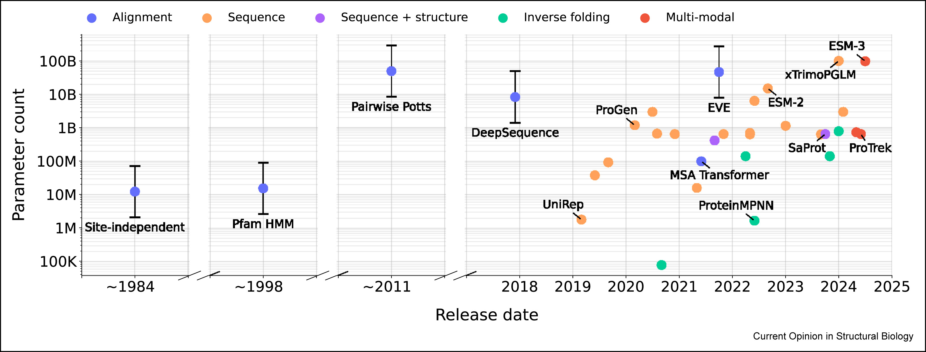
Protein Language Models
Notes:
Foundation models of protein sequences: A brief overview
Author links open overlay panelAndreas Bjerregaard ¹ ² ª, Peter Mørch Groth ¹ ³ ª, Søren Hauberg ⁴, Anders Krogh ¹ ², Wouter Boomsma ¹

Slide 32
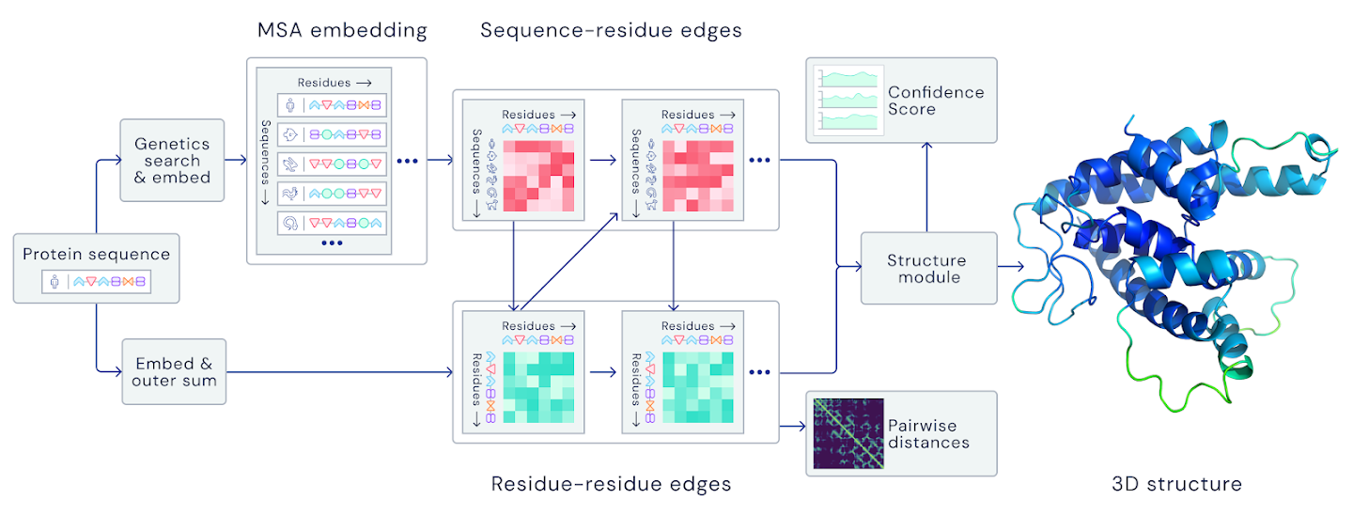
AlphaFold2
(Jumper, et al., Nature, 2021)

Slide 33
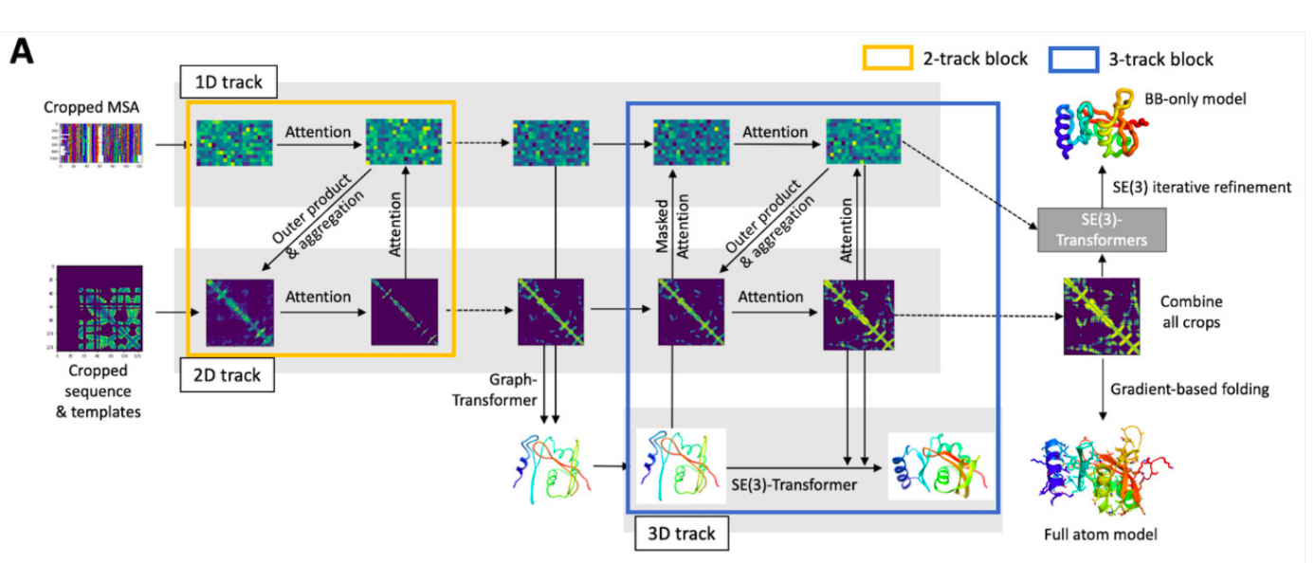
RoseTTAFold
(Baek, Science, 2021)

Slide 34
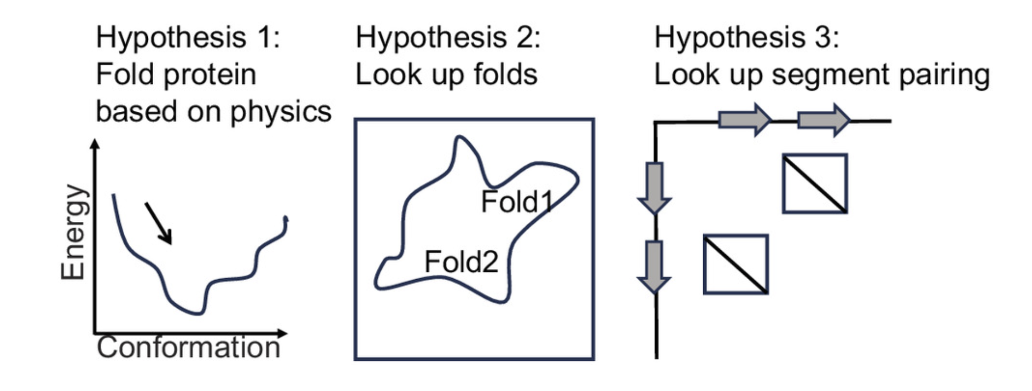
How to transformer / Protein language models work

Slide 35
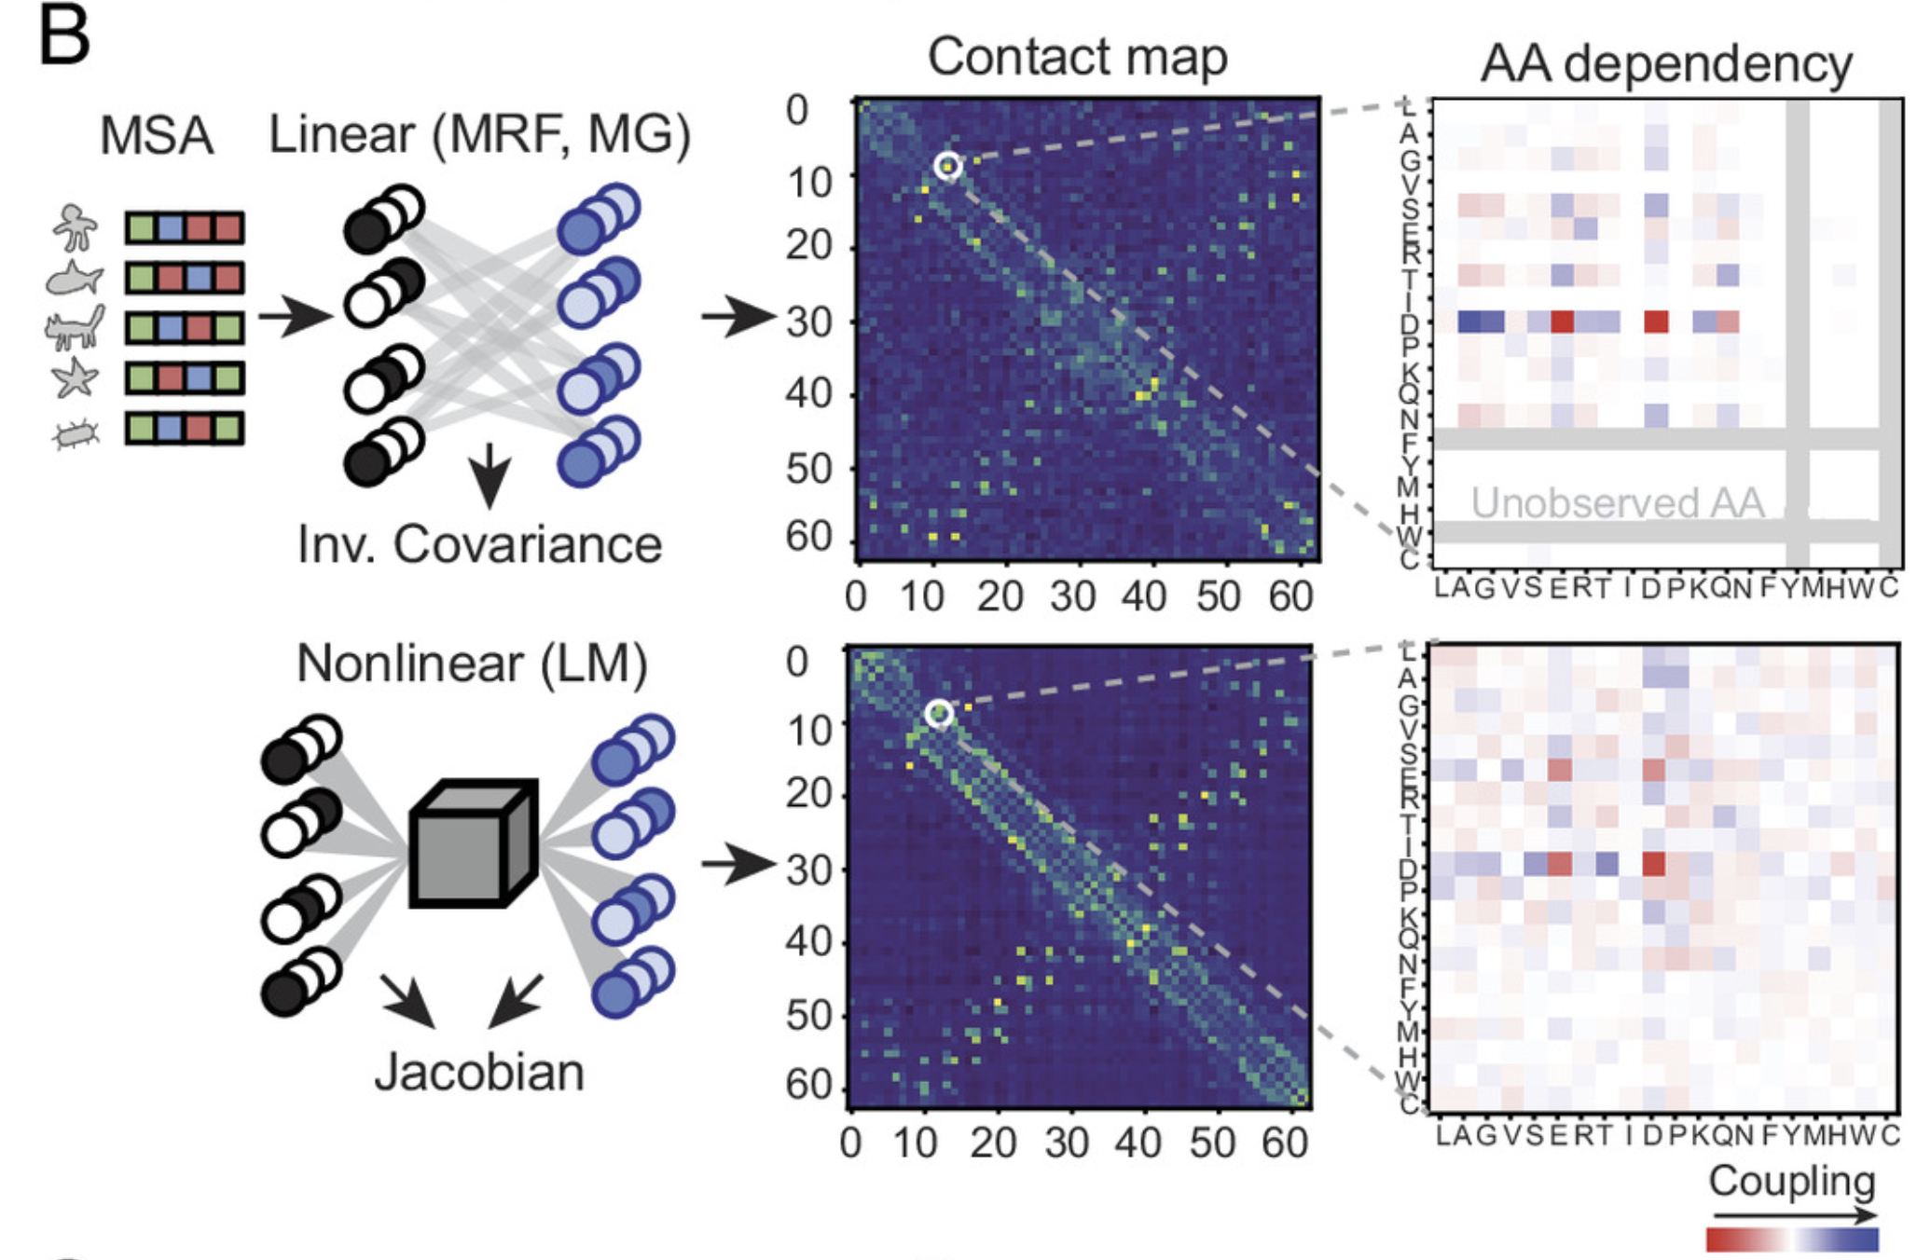

Slide 36
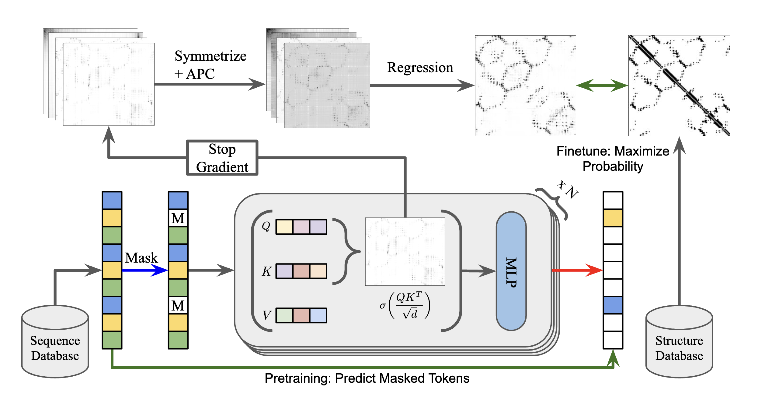
Transformers as pattern recognition machines

Slide 37

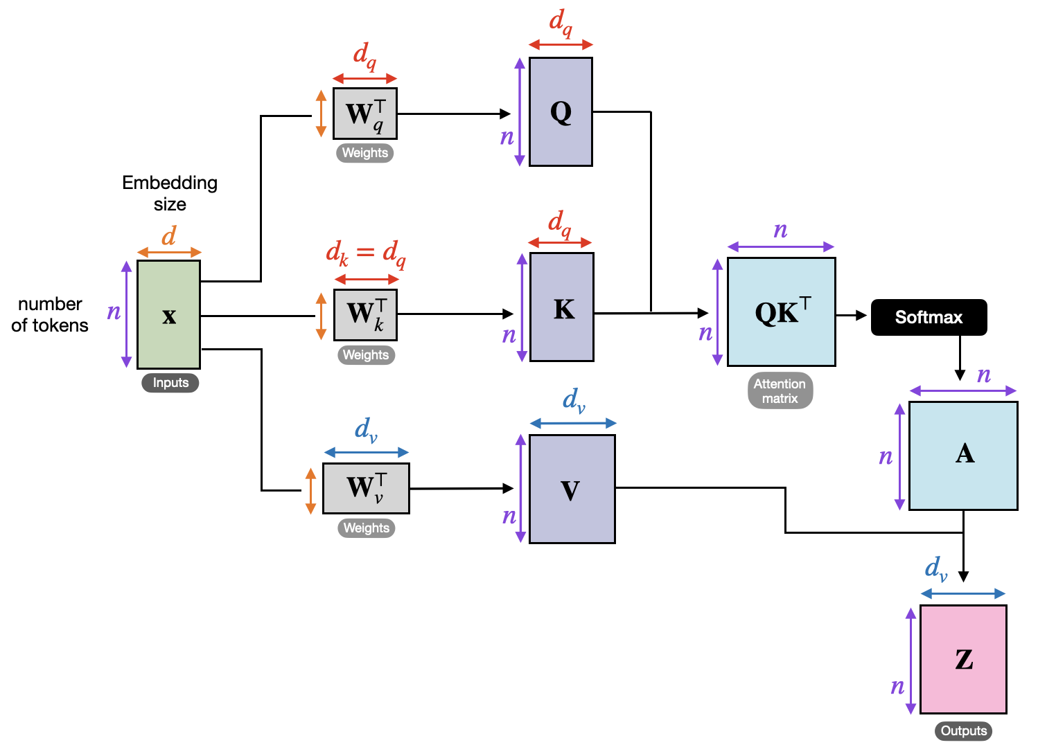
Computation in Transformer Attention Block

Slide 38
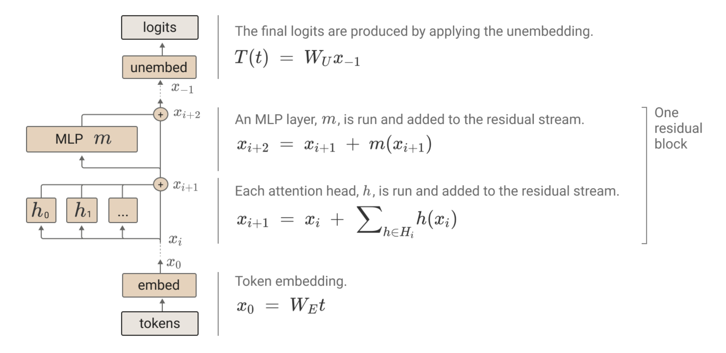
Transformer Circuits (Residual stream)

Slide 39
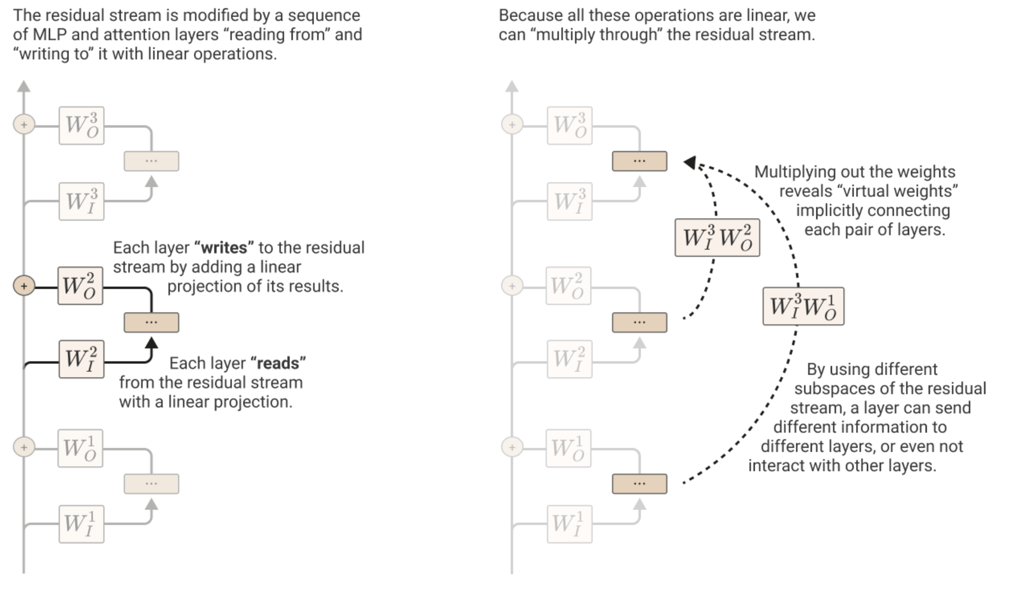
Reading and Writing

Slide 40
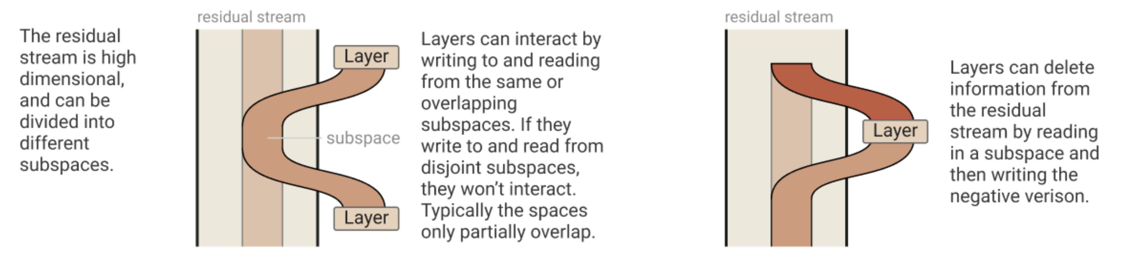
Storing and retrieving data in the residual stream

Slide 41
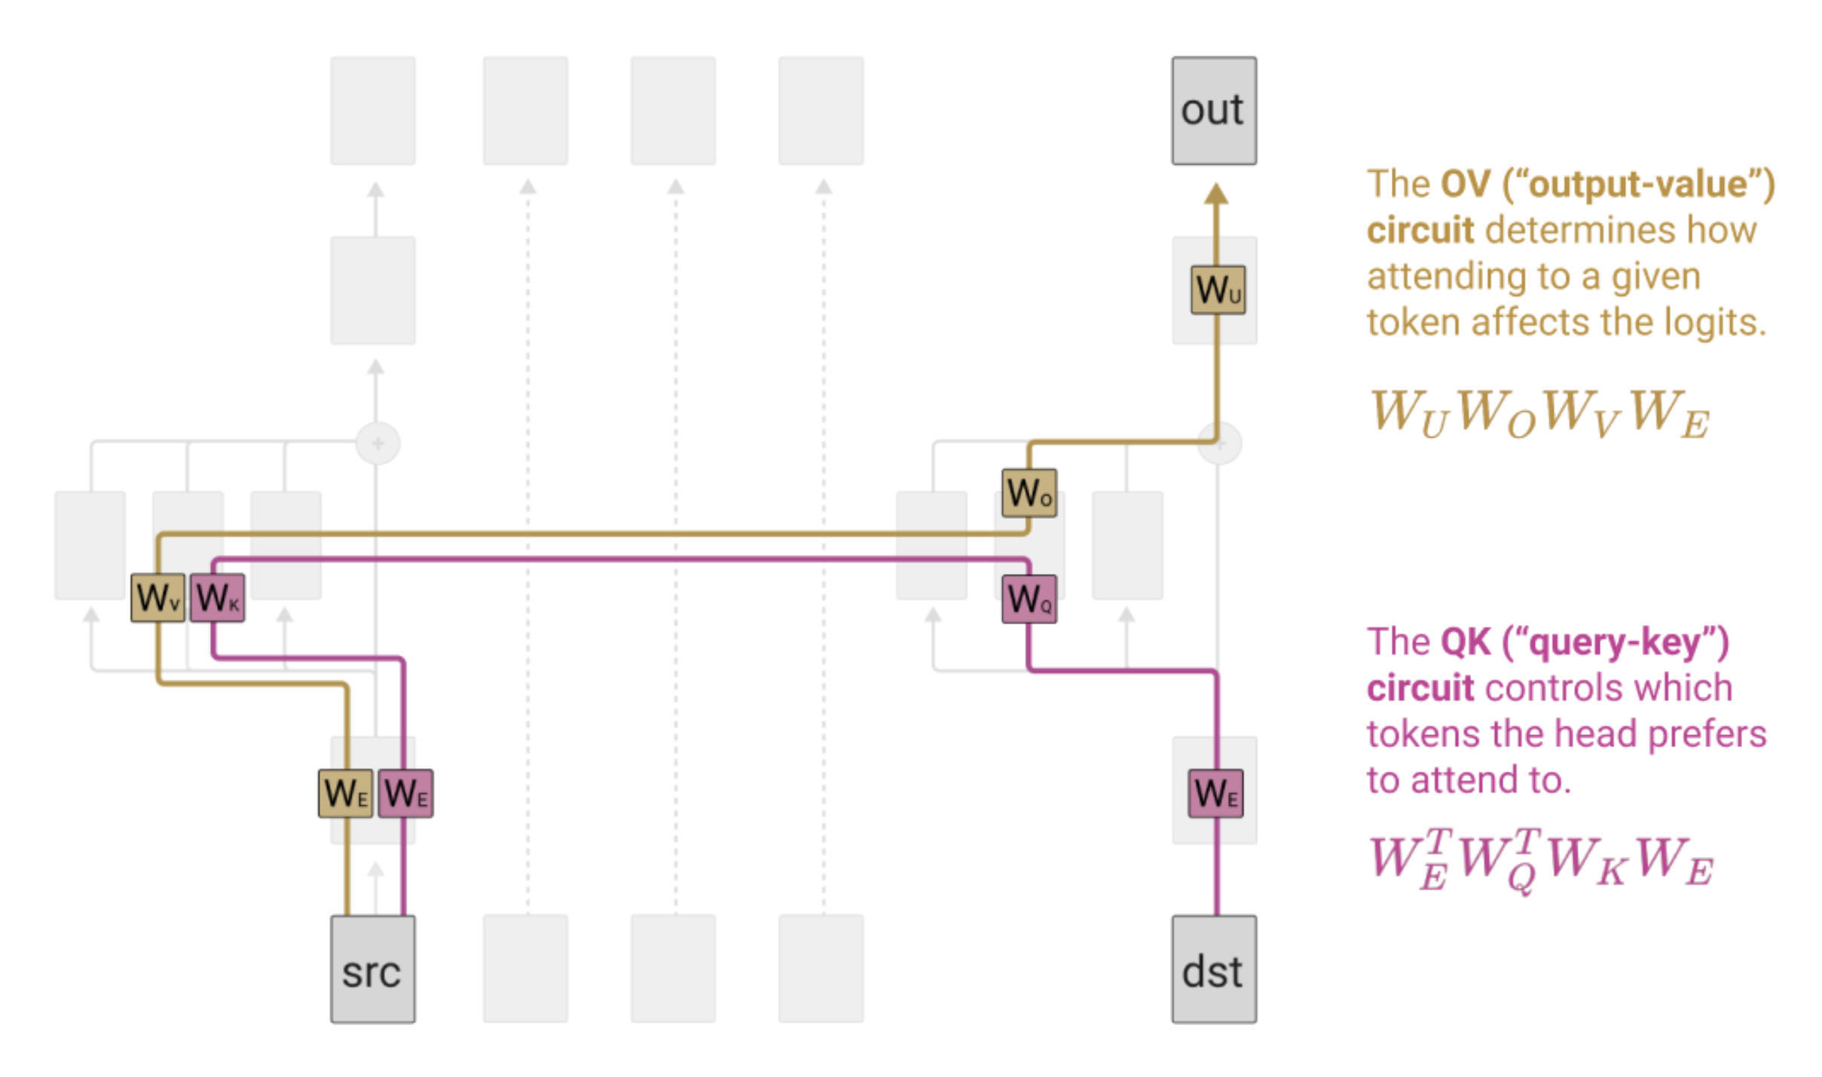
Gated copying from one stream to another

Slide 42
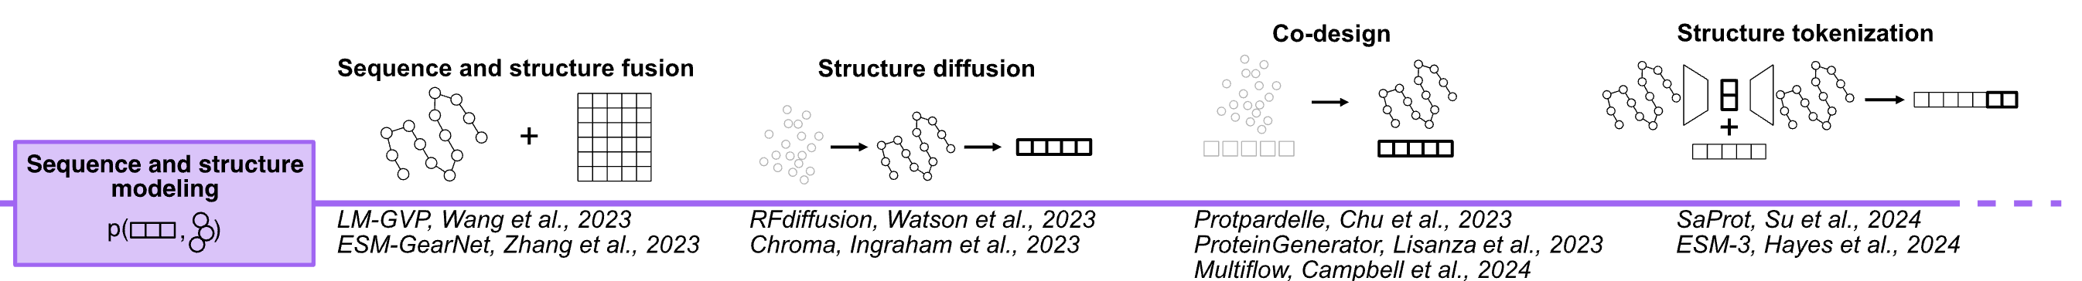
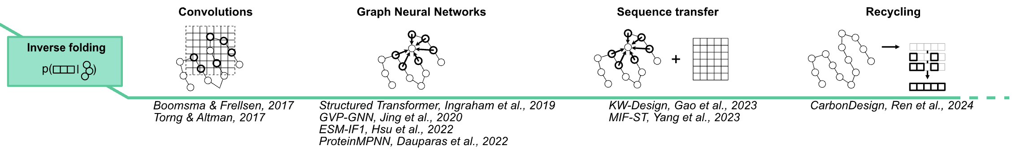

Slide 43
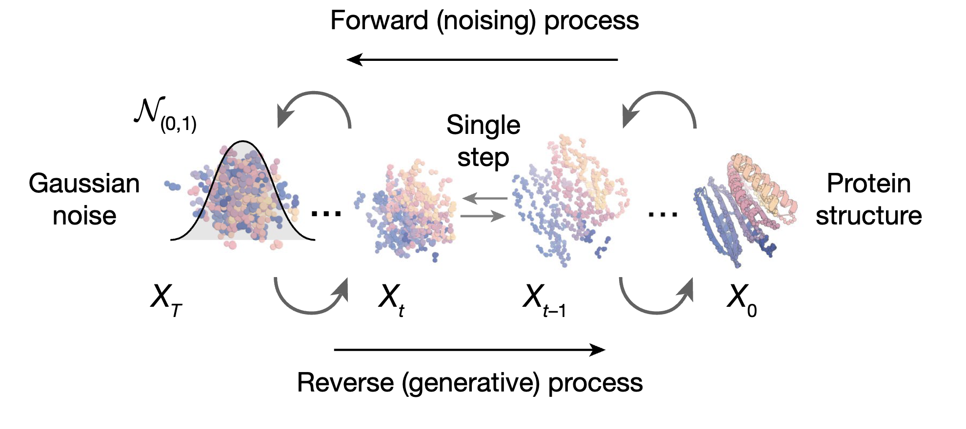
RFDiffusion
(Watson et al., 2023)

Slide 44
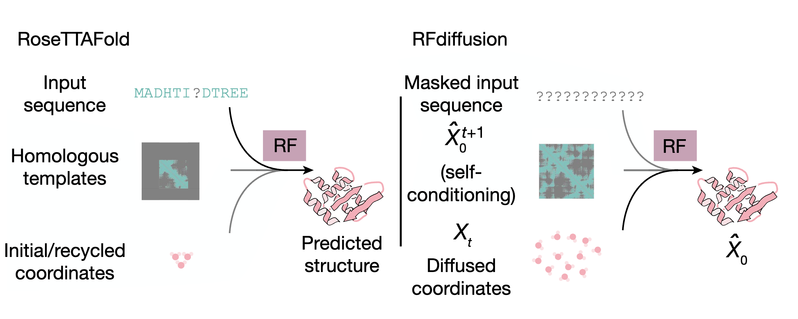
RoseTTAFold
RFDiffusion

Slide 45
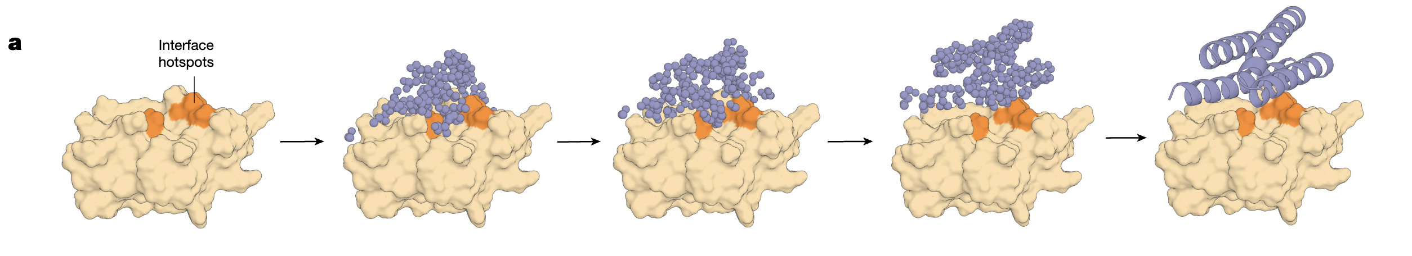
Conditional structure generation (Binder design)

Slide 46
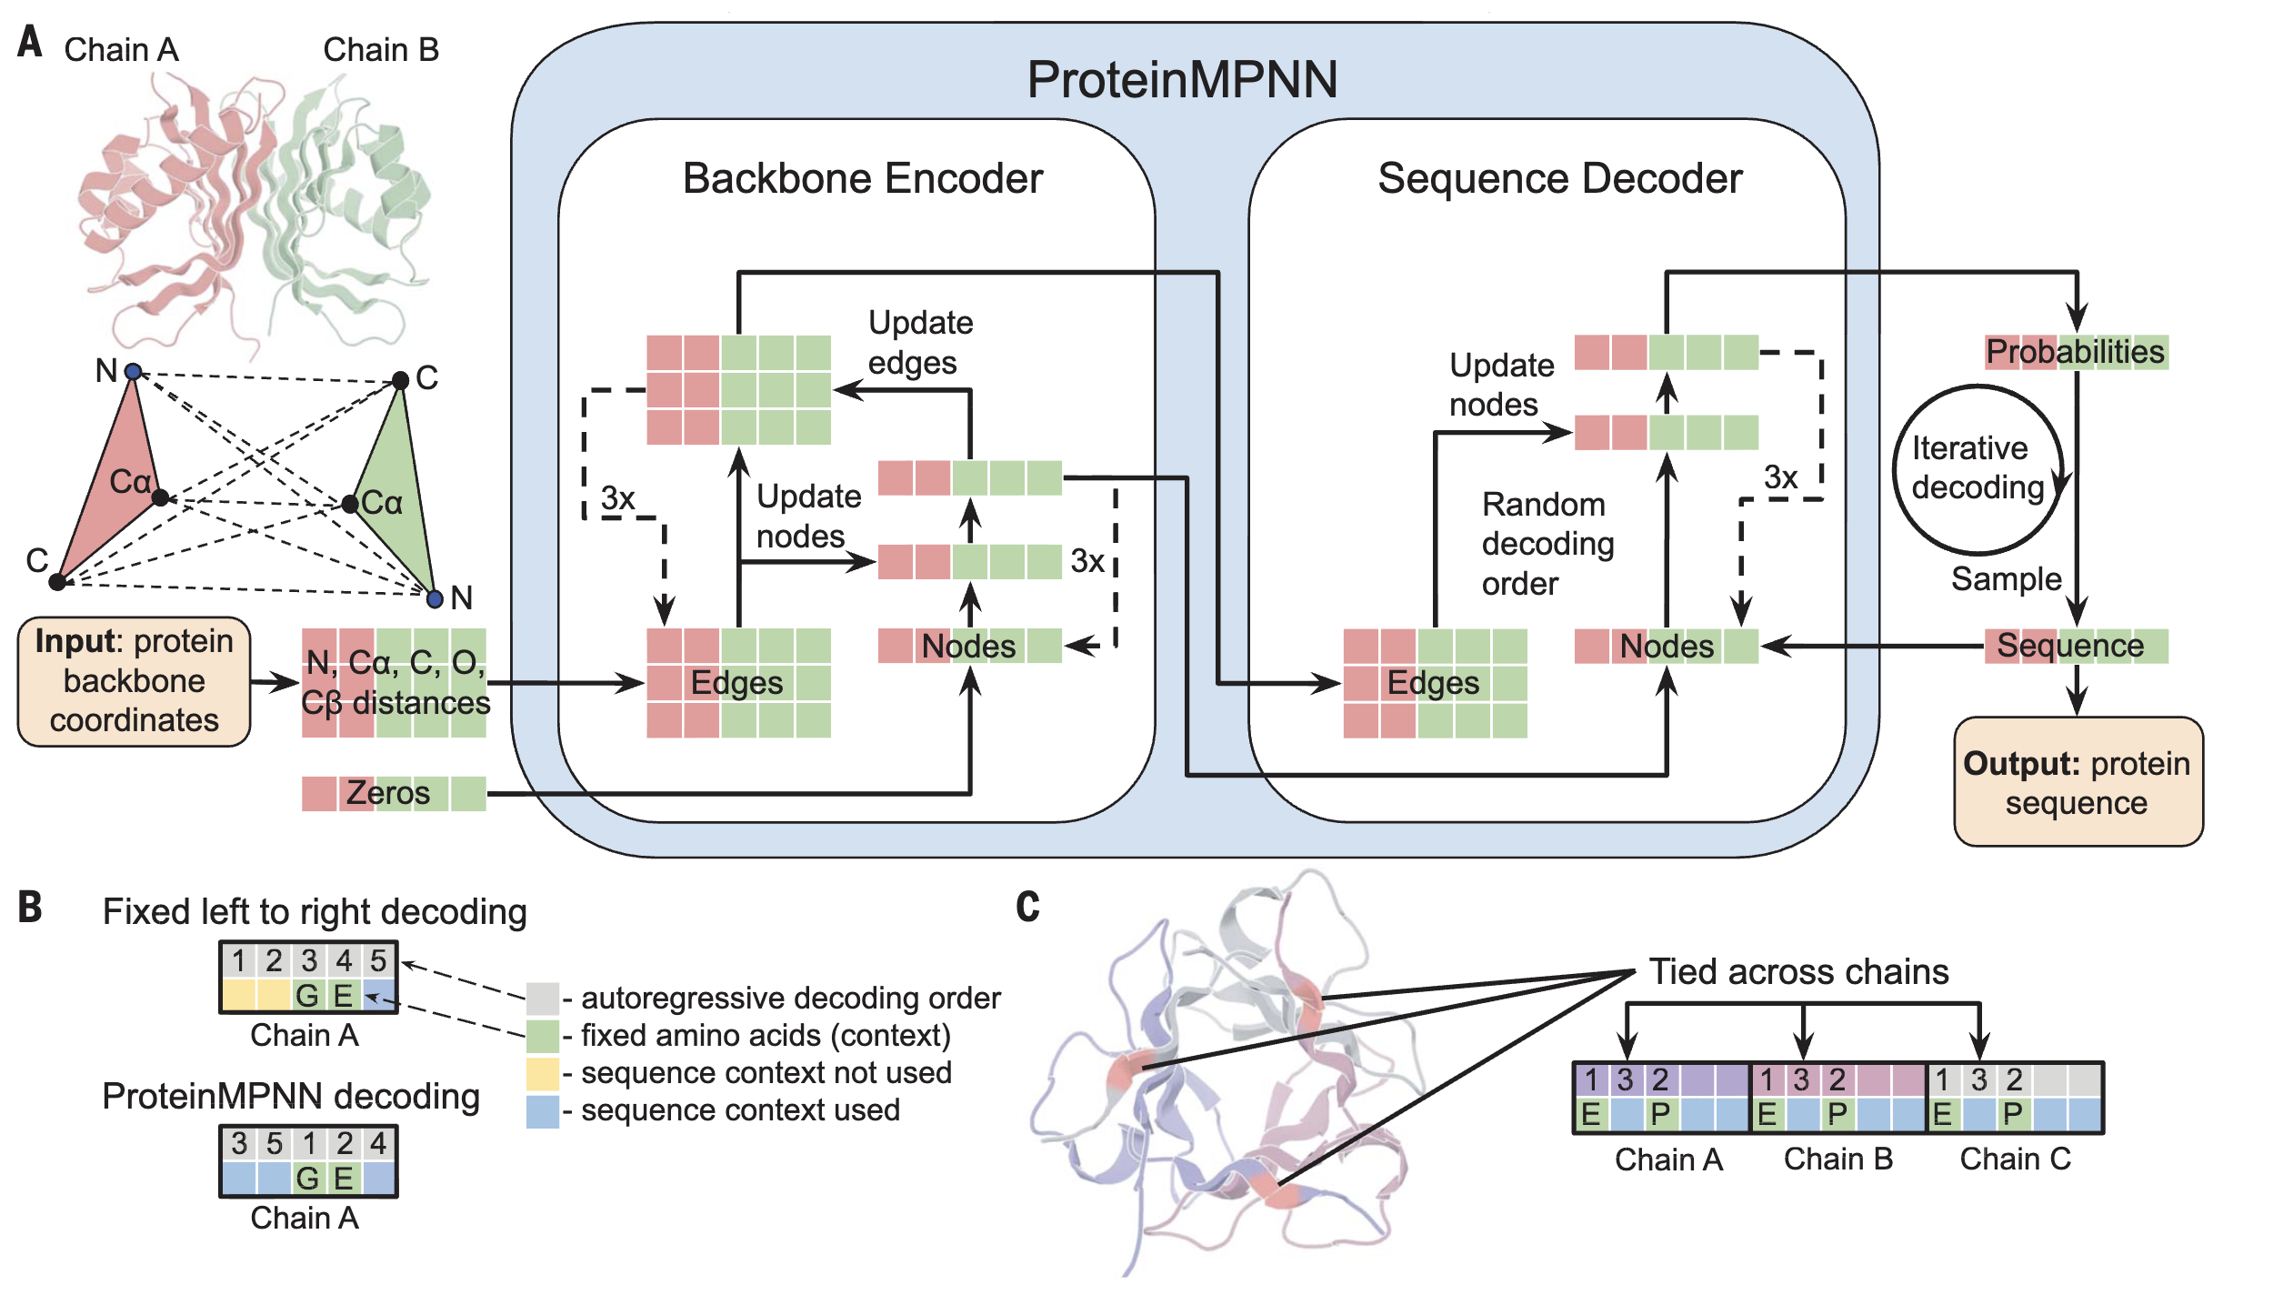
ProteinMPNN: P(seq | struct)

Slide 47
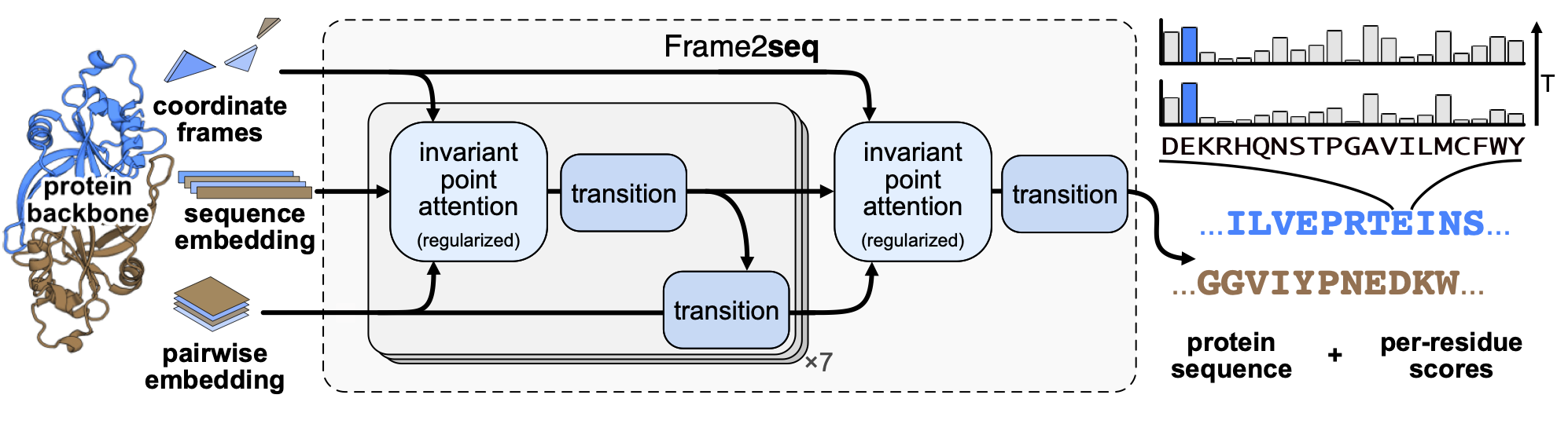
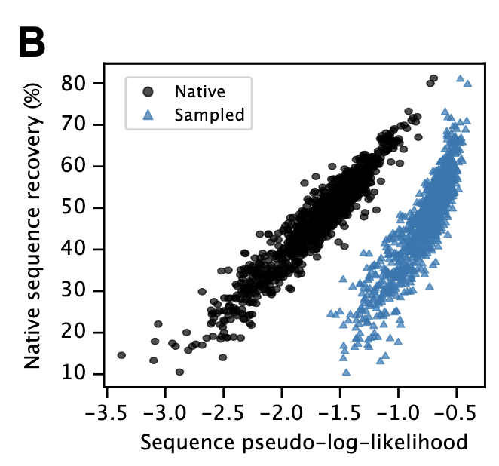
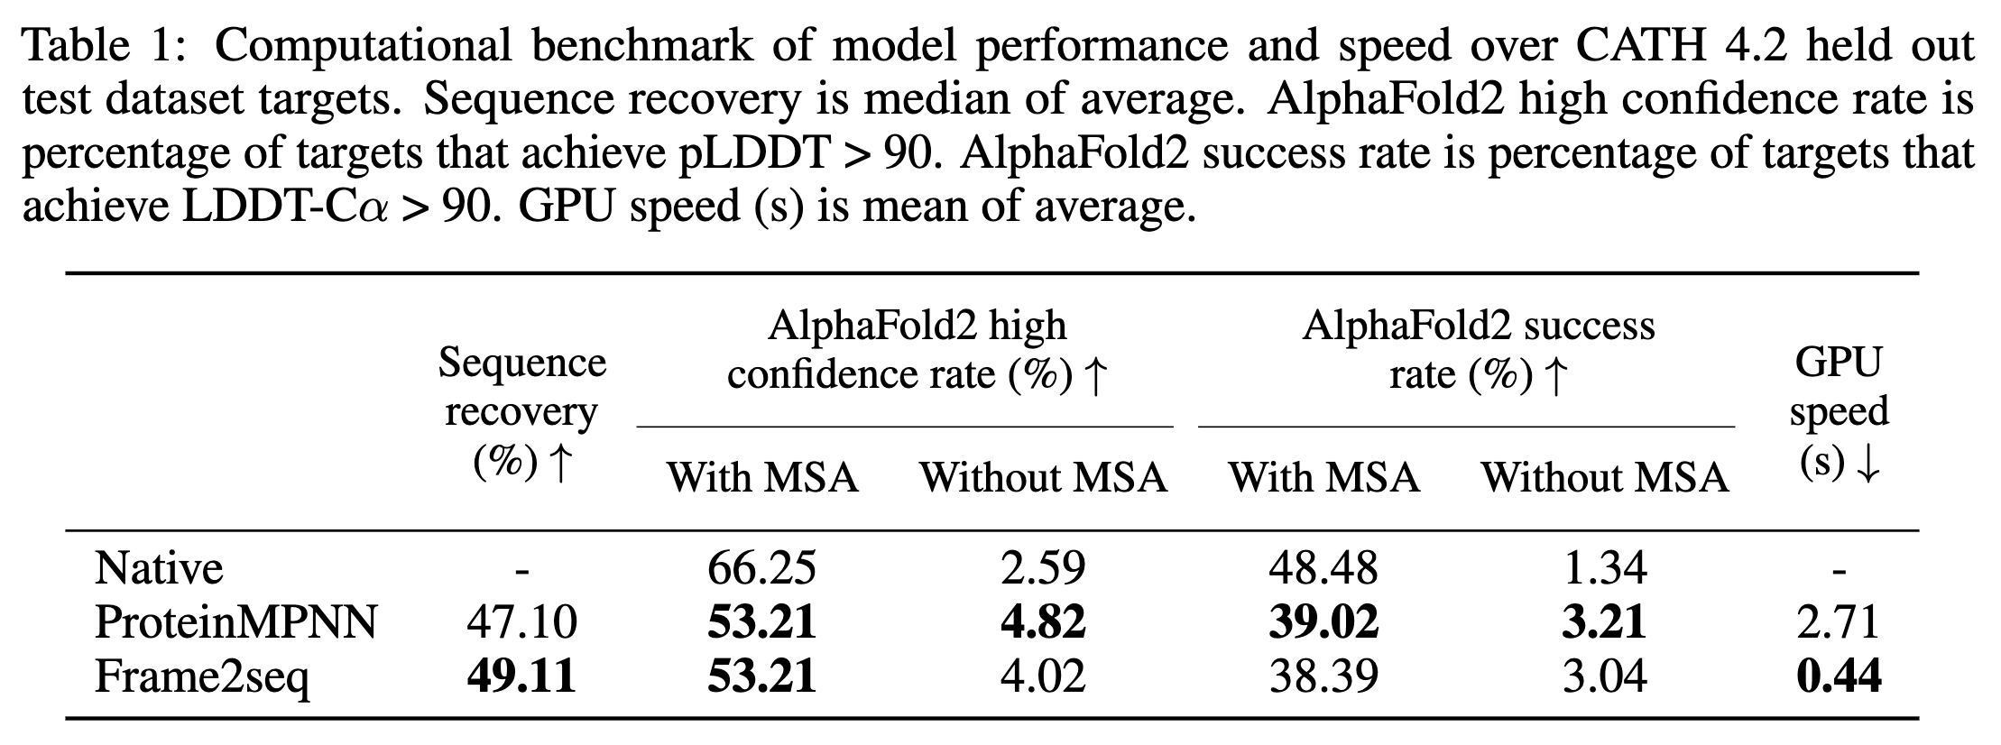
Frame2seq (seq | struct)
Given a protein backbone => design a sequence
(Akpinaroglu, 2023, 10.1101/2023.12.15.571823)

Slide 48
Design workflow for protein redesign
AlphaFold3
Relevant reference structures as templates
Identify portions to keep, redesign
RFDiffusion
Generate ensemble of backbone structures
Conditional on portions of templates
ProteinMPNN or Frame2Seq
Generate sequences conditional on backbones
AlphaFold3
Evaluate predicted quality of structure (pLDDT)
Experimentally test
Expression
Stability
Function

Slide 49
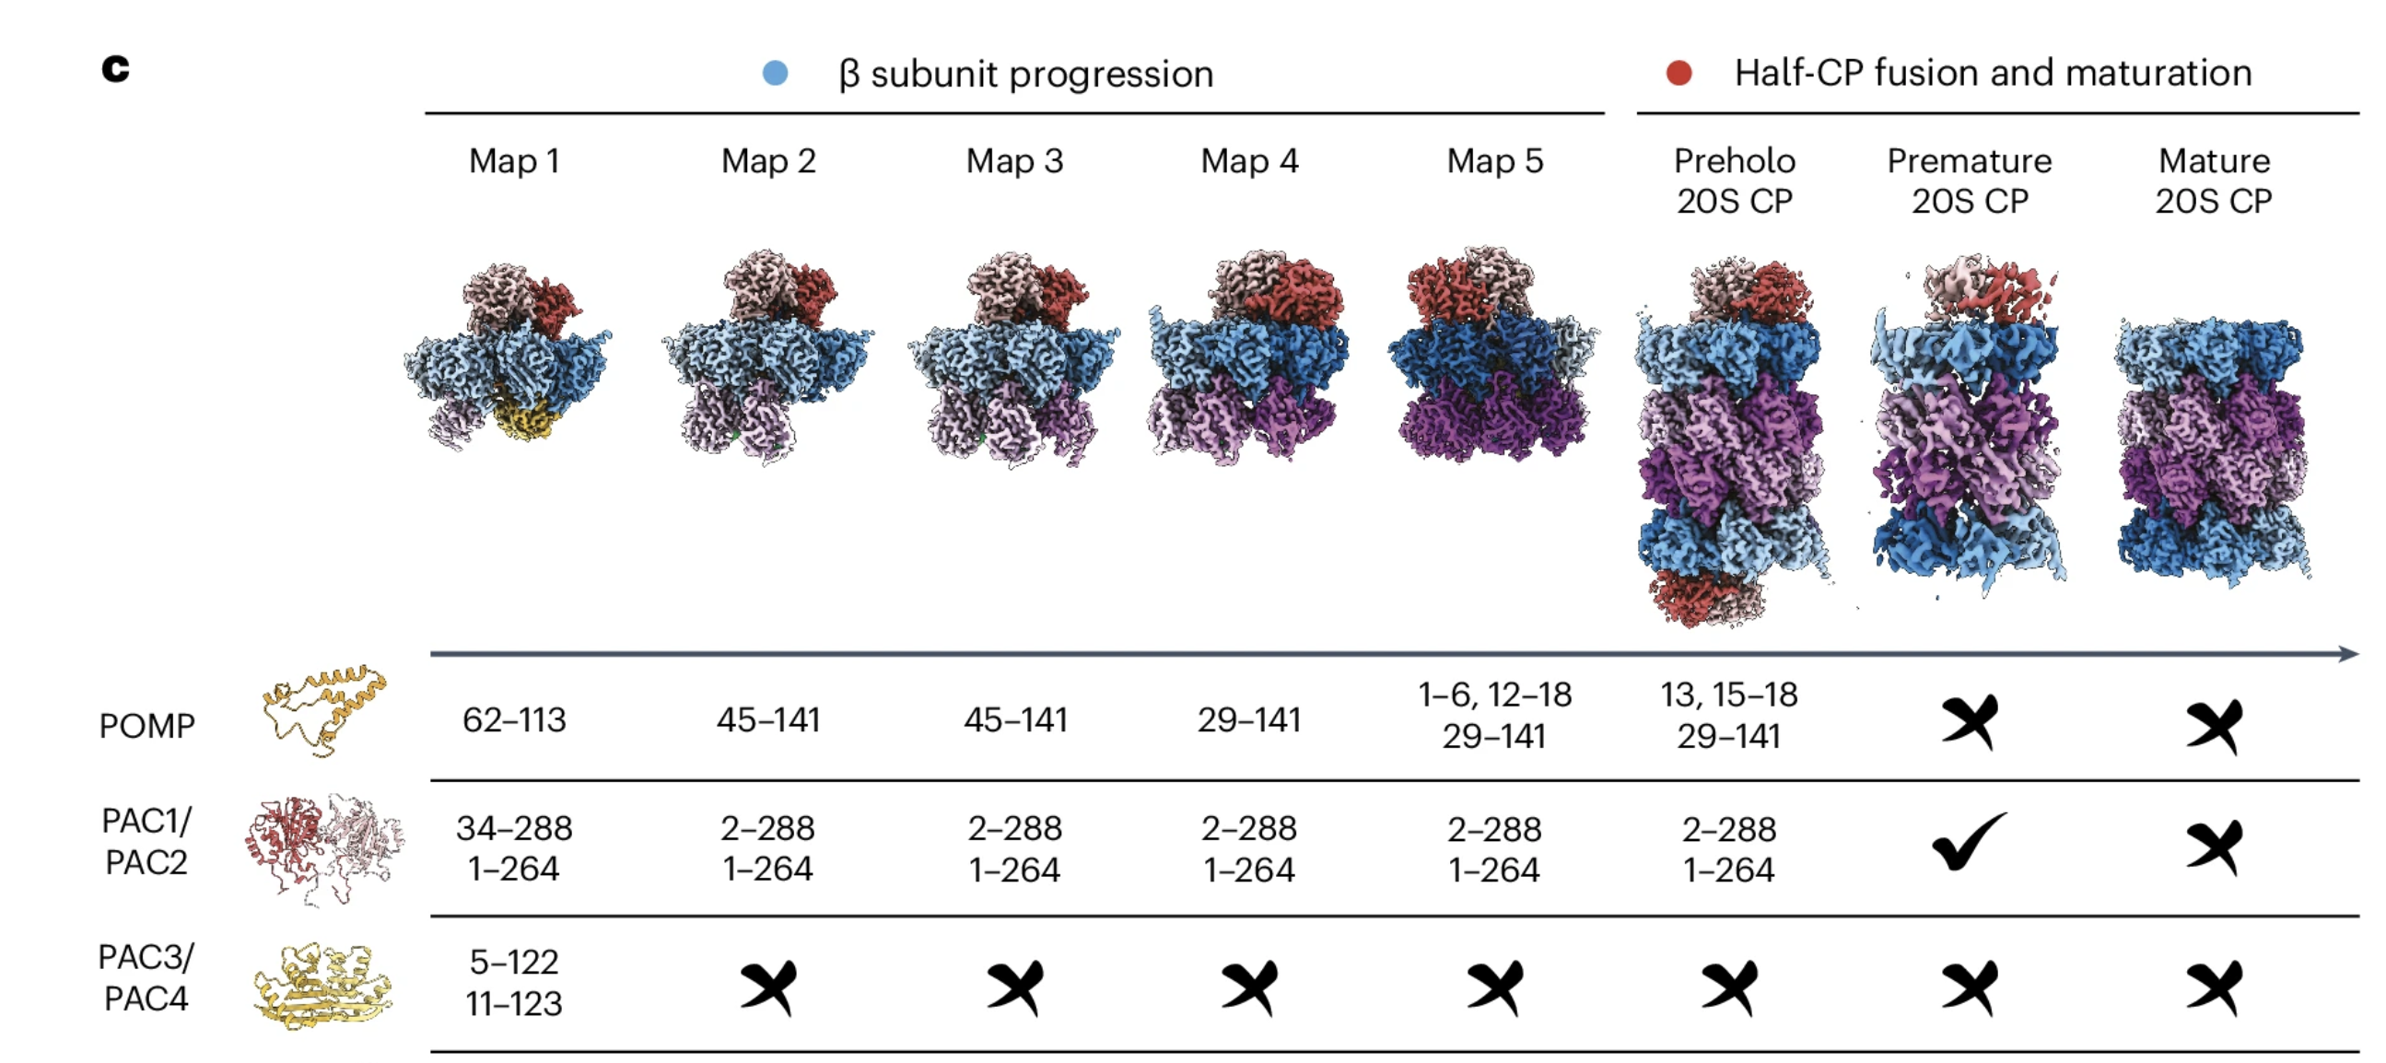
Human Proteasome structures

Slide 50

AF3 of whole complex?
Human Proteasome CryoEM

Slide 51

AF3 Prediction of 884/IRC25 complex
884
IRC25

Slide 52

Embedding of Poc3 / Poc4 natural sequences

Slide 53


Unconstrained designs

Slide 54

Frame2Seq design
Score:
Lower is better
Fix interface
1,3,5,12,14,16,18,24,25,26,28,30,32,33,34,35,36,37,38,39,42,44,55,56,57,58,83,85,87
!> frame2seq_metadata |> dplyr::arrange(score)
# A tibble: 5,000 × 3
seq_id recovery_percent score
<chr> <dbl> <dbl>
1 seq_10 72.1 0.47
2 seq_1483 64.0 0.49
3 seq_1734 67.6 0.49
4 seq_4949 63.1 0.49
5 seq_722 68.5 0.5
6 seq_1326 64.9 0.5
7 seq_2193 68.5 0.5
8 seq_2421 63.1 0.5
9 seq_4271 65.8 0.5
10 seq_2303 62.2 0.51
AF3 structure
884
IRC25

Slide 55

Design 10

Slide 56

Compare design 10 with 884/IRC25 using AF3
Light green = 884
Dark green = Design10

Slide 57

Embedding of constrained designs

Slide 58

State of the art in ab initio protein folding

Slide 59


Recent applications Predictions on Uniprot
(Tunyasuvunakool, Nature, 2021)

Slide 60


Recent applications Protein-protein interactions
(Humphres, Science, 2021)

